Slide 1
What’s New in SAFe® 4.5?

Slide 2
SAFe® 4.5 Vision
Configurability (and improve usability)
Essential SAFe
Implementation Roadmap
Scalable DevOps and Continuous Delivery

Slide 3
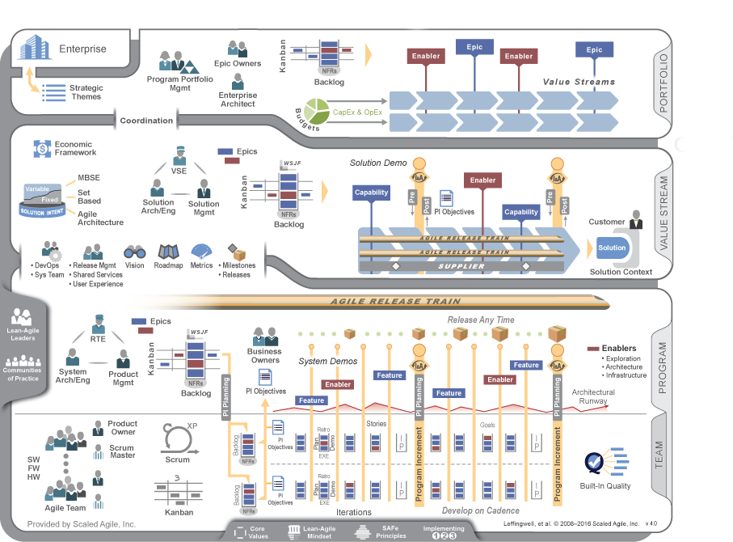
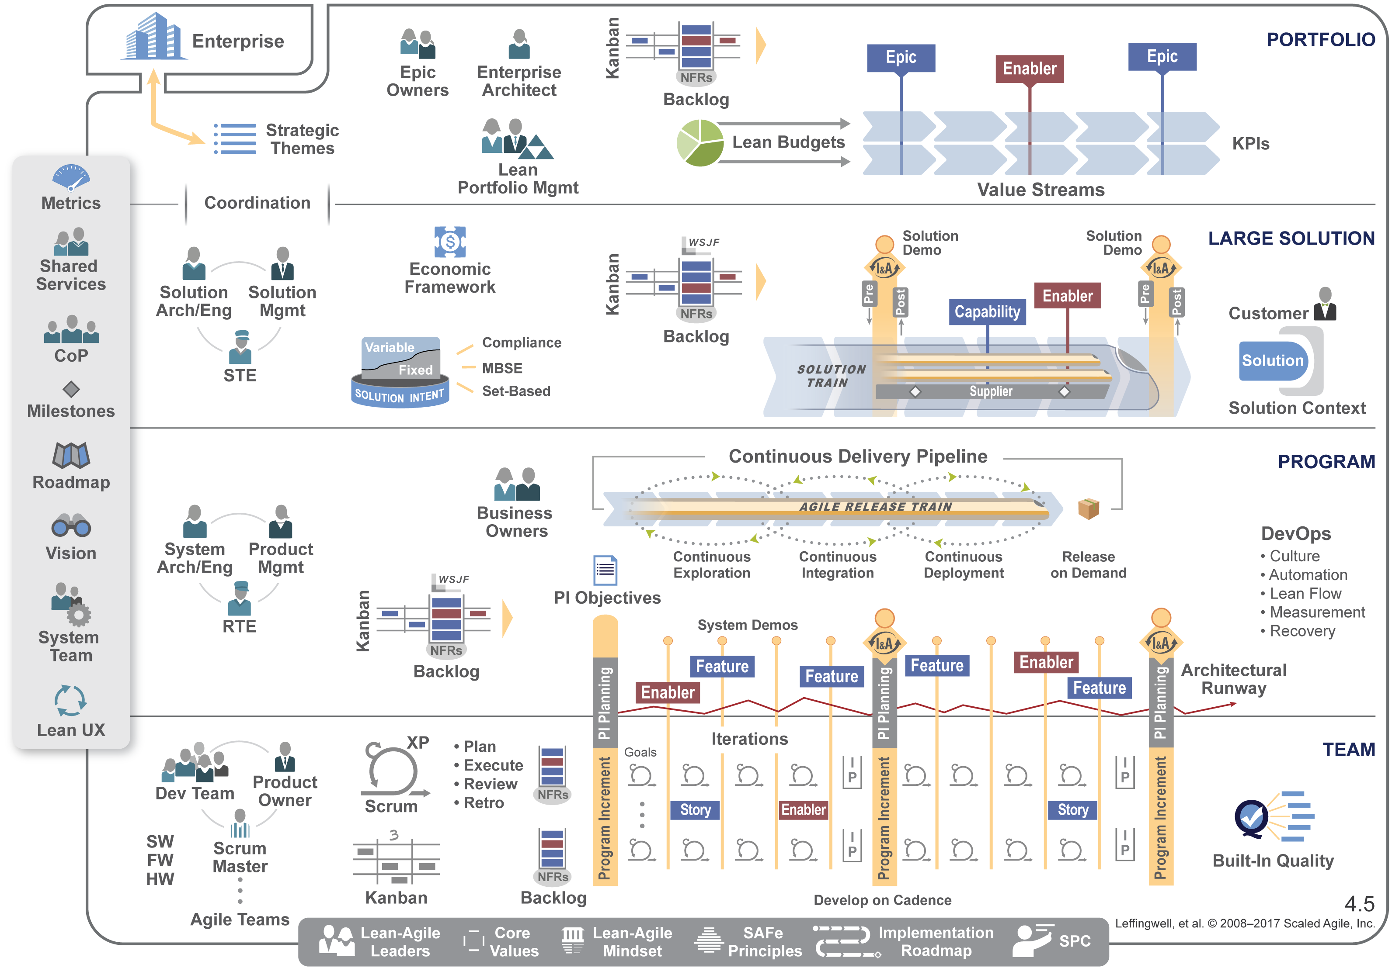
SAFe 4.5 is backwards compatible with SAFe 4.0

Slide 4
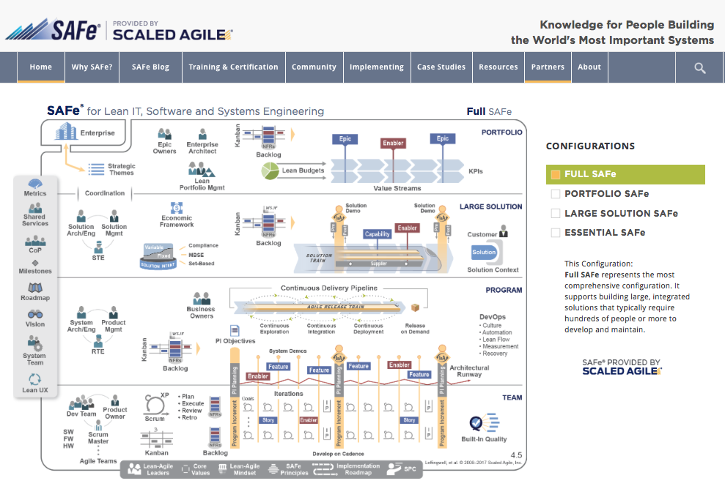
2
3
4
5
12
11
1
6
7
8
9
10
13
Notes:
Improve BP Usability
New Menu structure
New name for Big Picture
Configurable Framework
Spanning Palette
Lean UX
Continuous Delivery Pipeline
Scalable DevOps
Implementation Roadmap
SAFe Program Consultant
Epic - Lean-Startup
Other important stuff

Slide 5
Summary of Changes
1
Improve Big Picture Usability
7
Scalable DevOps
2
Updated Menu Structure
8
Lean UX
3
New name for Big Picture
9
Implementation Roadmap
4
Configurable Framework
10
SAFe Program Consultant
5
Spanning Palette
11
Solution Train
6
Continuous Delivery Pipeline
12
Compliance
13
Other important stuff

Slide 6
Improve Big Picture Usability
1

Slide 7
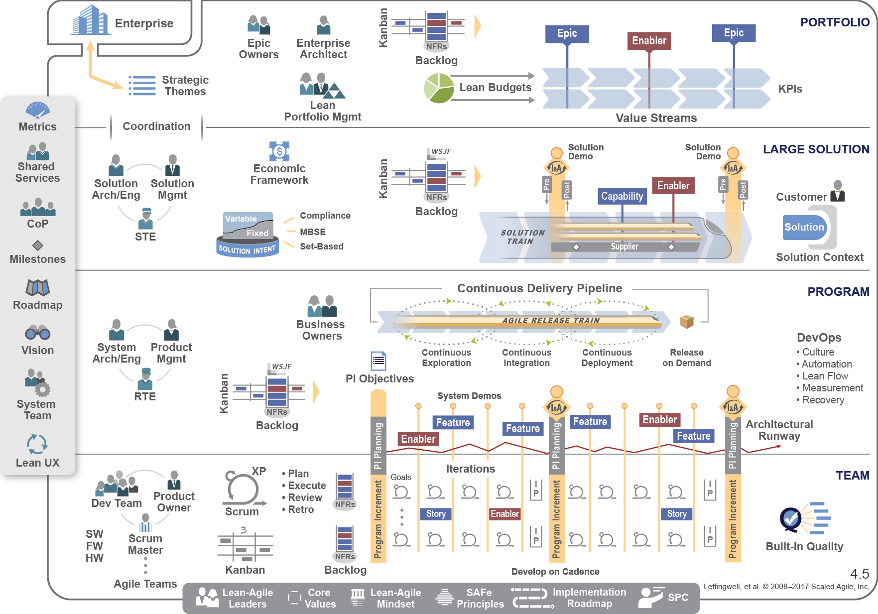

Slide 8
Updated Menu structure
2

Slide 9
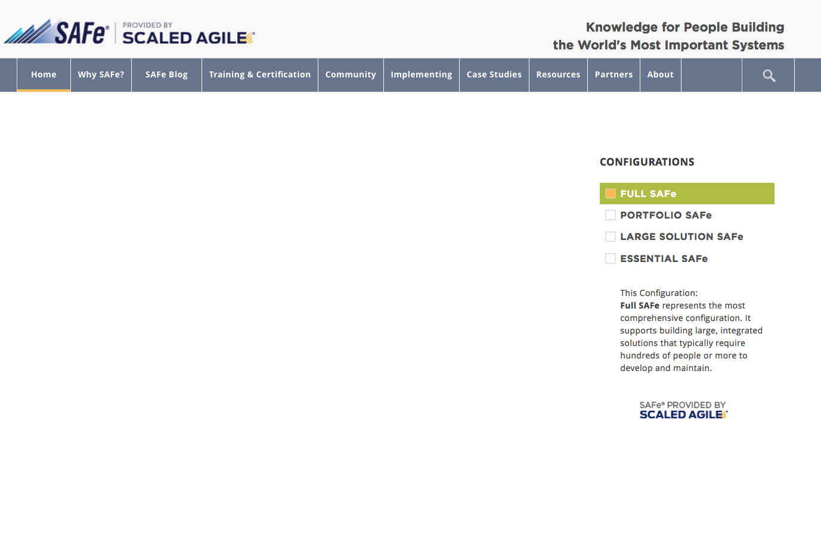
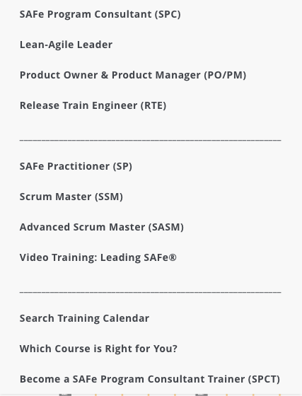
Updated menu structure Training & Certification

Slide 10
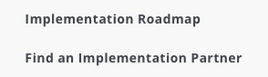
Updated menu structure Implementation

Slide 11
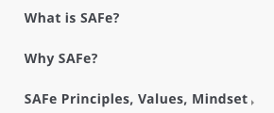
Updated menu structure SAFe Overview

Slide 12
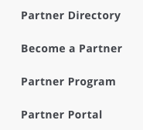
Updated menu structure SAFe Partners

Slide 13
New Name for SAFe
3

Slide 14
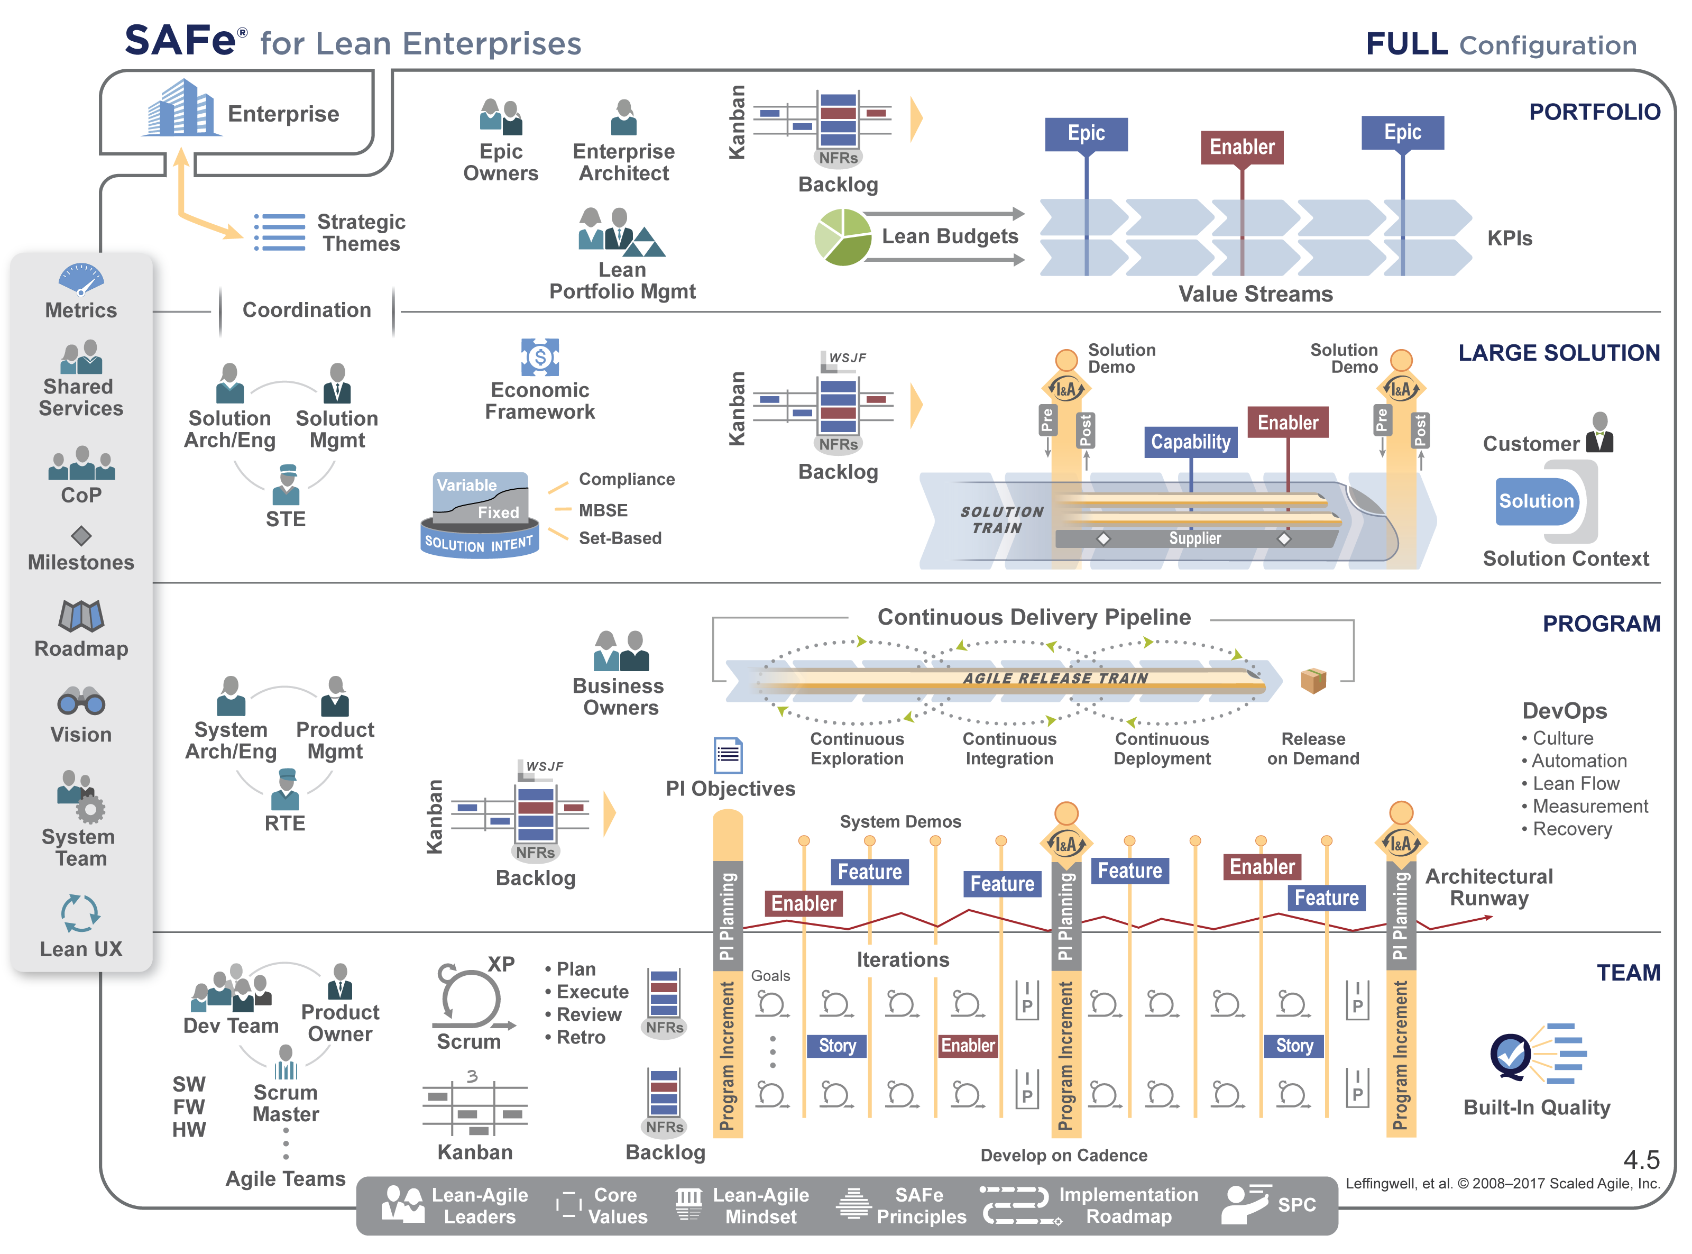

Slide 15
Configurable Framework
4

Slide 16
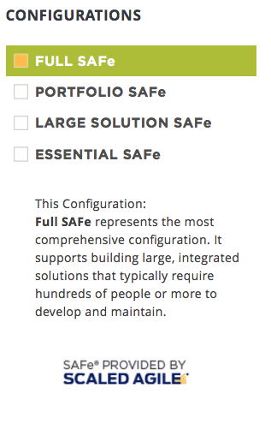
Full SAFe configuration

Slide 17
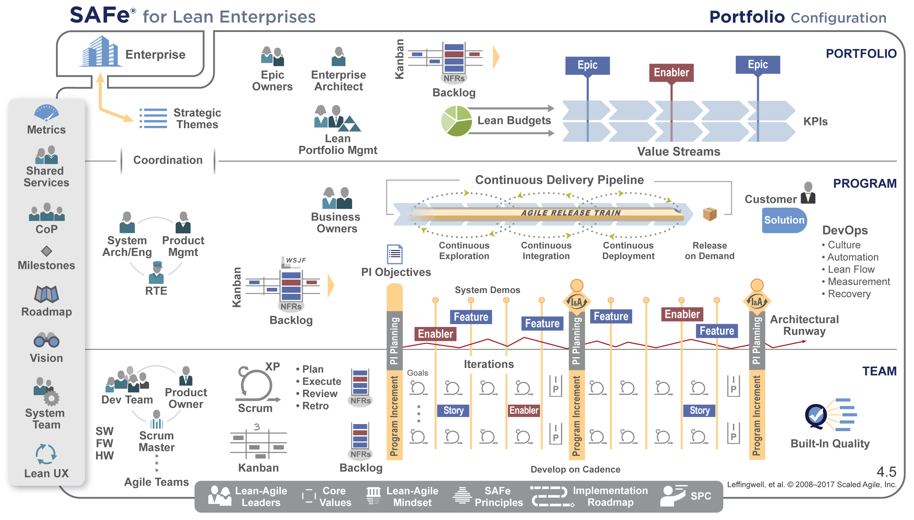
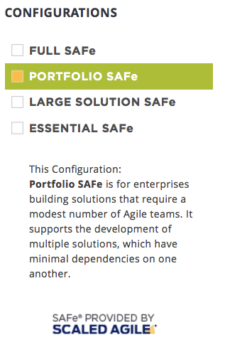
Portfolio SAFe configuration

Slide 18
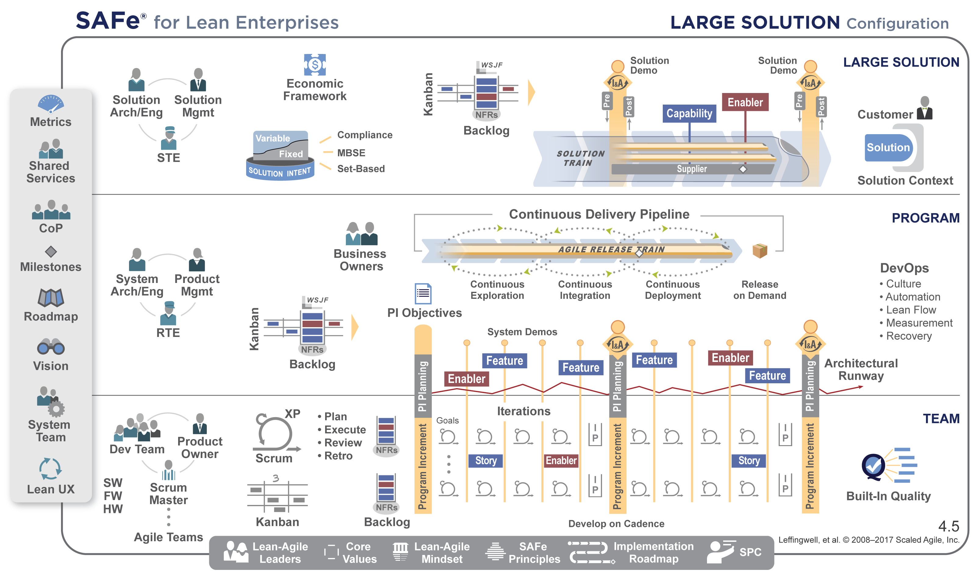
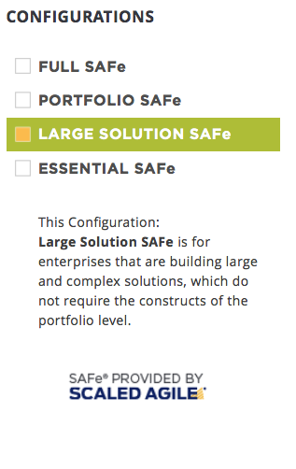
Large Solution SAFe configuration

Slide 19
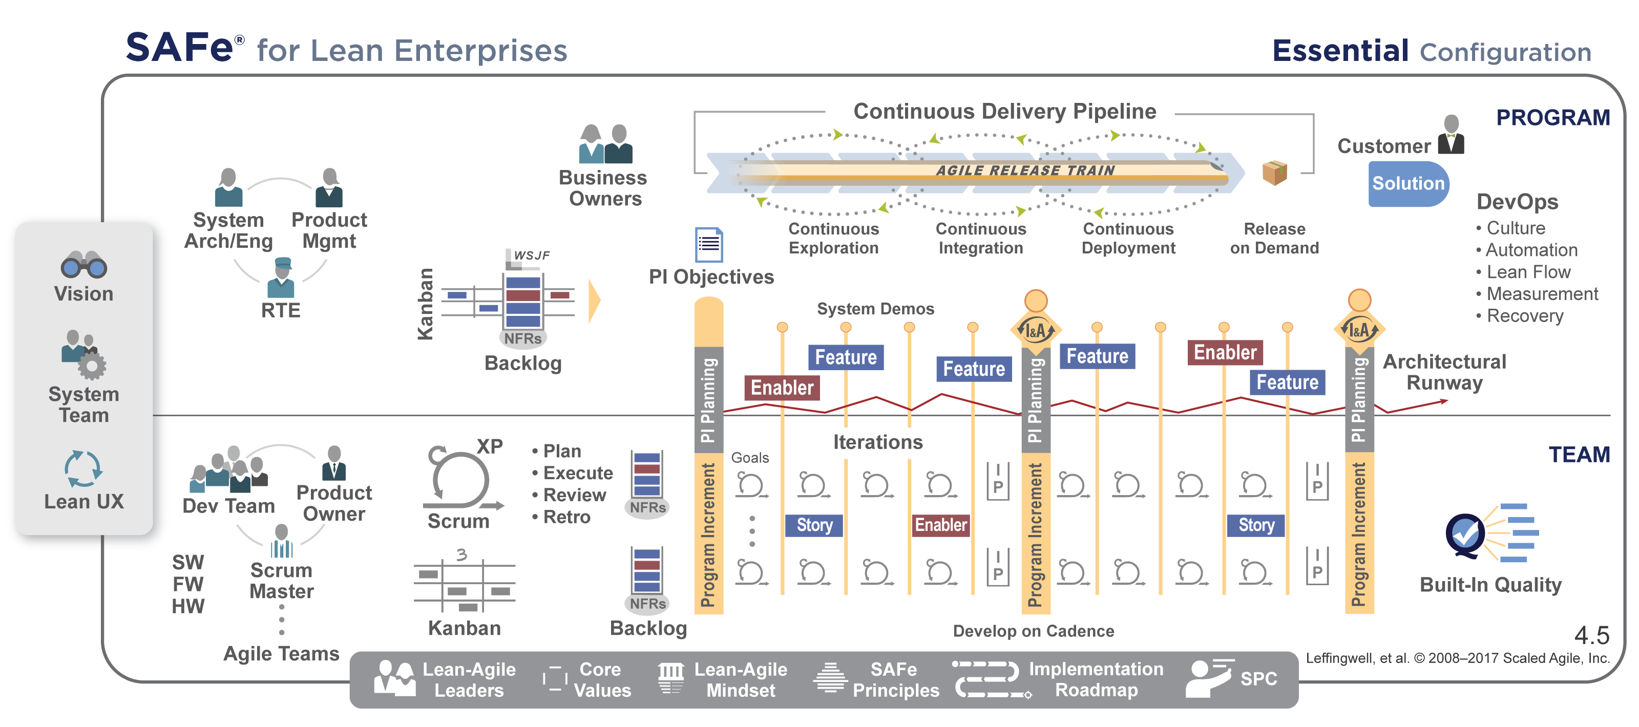
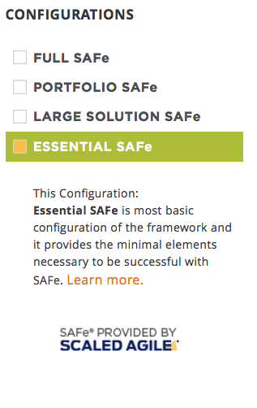
Essential SAFe configuration

Slide 20
Updated Spanning Palette
5

Slide 21
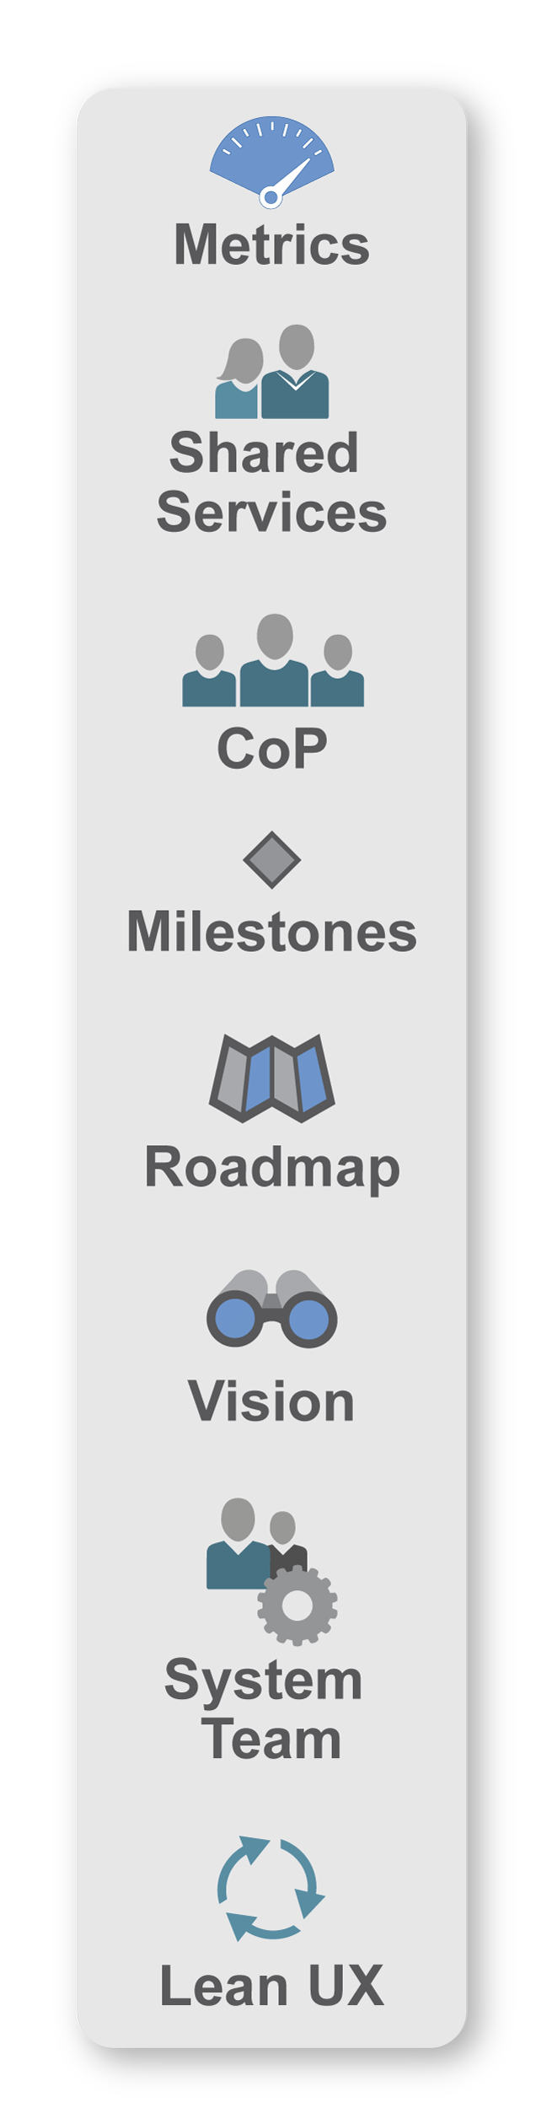
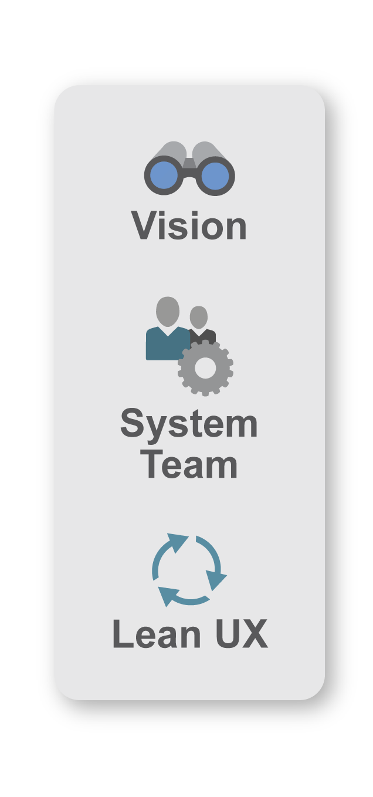
The Spanning Palette is configuration specific.
Essential
SAFe
Full SAFe
Portfolio SAFe
Large Solution SAFe

Slide 22
Continuous Delivery Pipeline
6

Slide 23
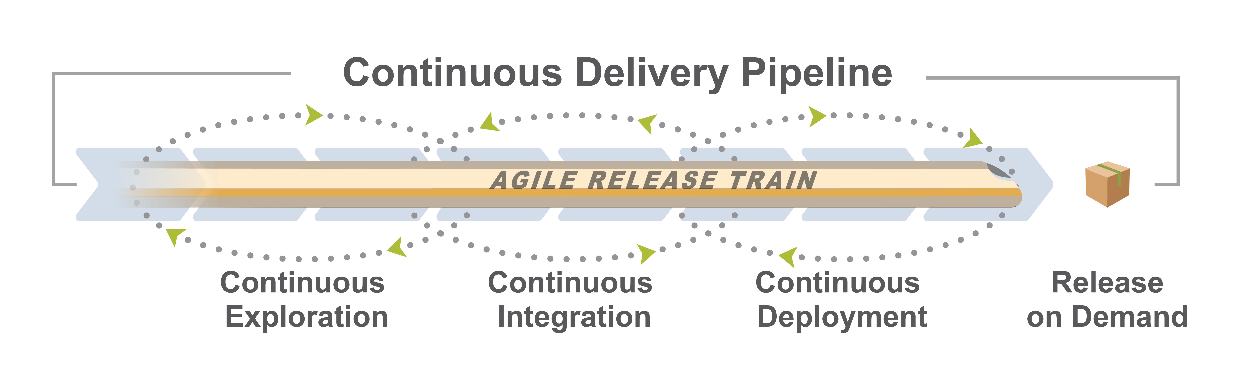
New article
New article
New article
New article

Slide 24
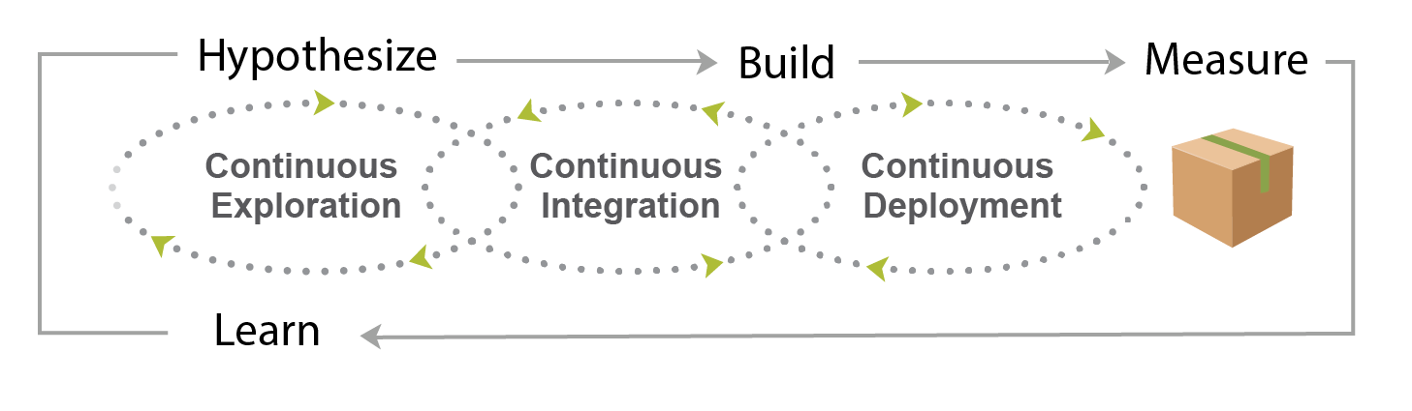
Hypothesize, Build, Measure, Learn

Slide 25
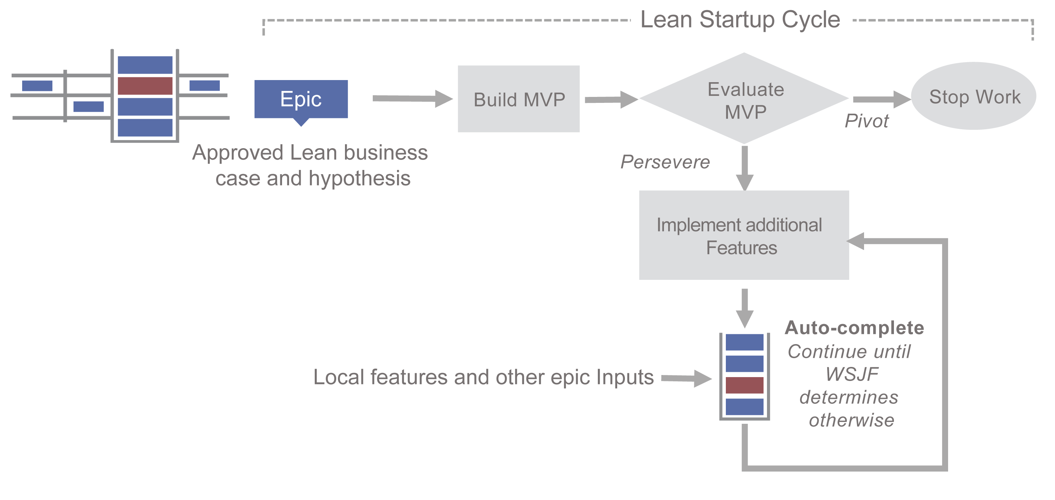
Foster Innovation with the Lean Startup Cycle
Learn more:
Ries, Eric. The Lean Startup: How Today’s Entrepreneurs Use Continuous Innovation to Create Radically Successful Businesses. Random House, Inc.

Slide 26
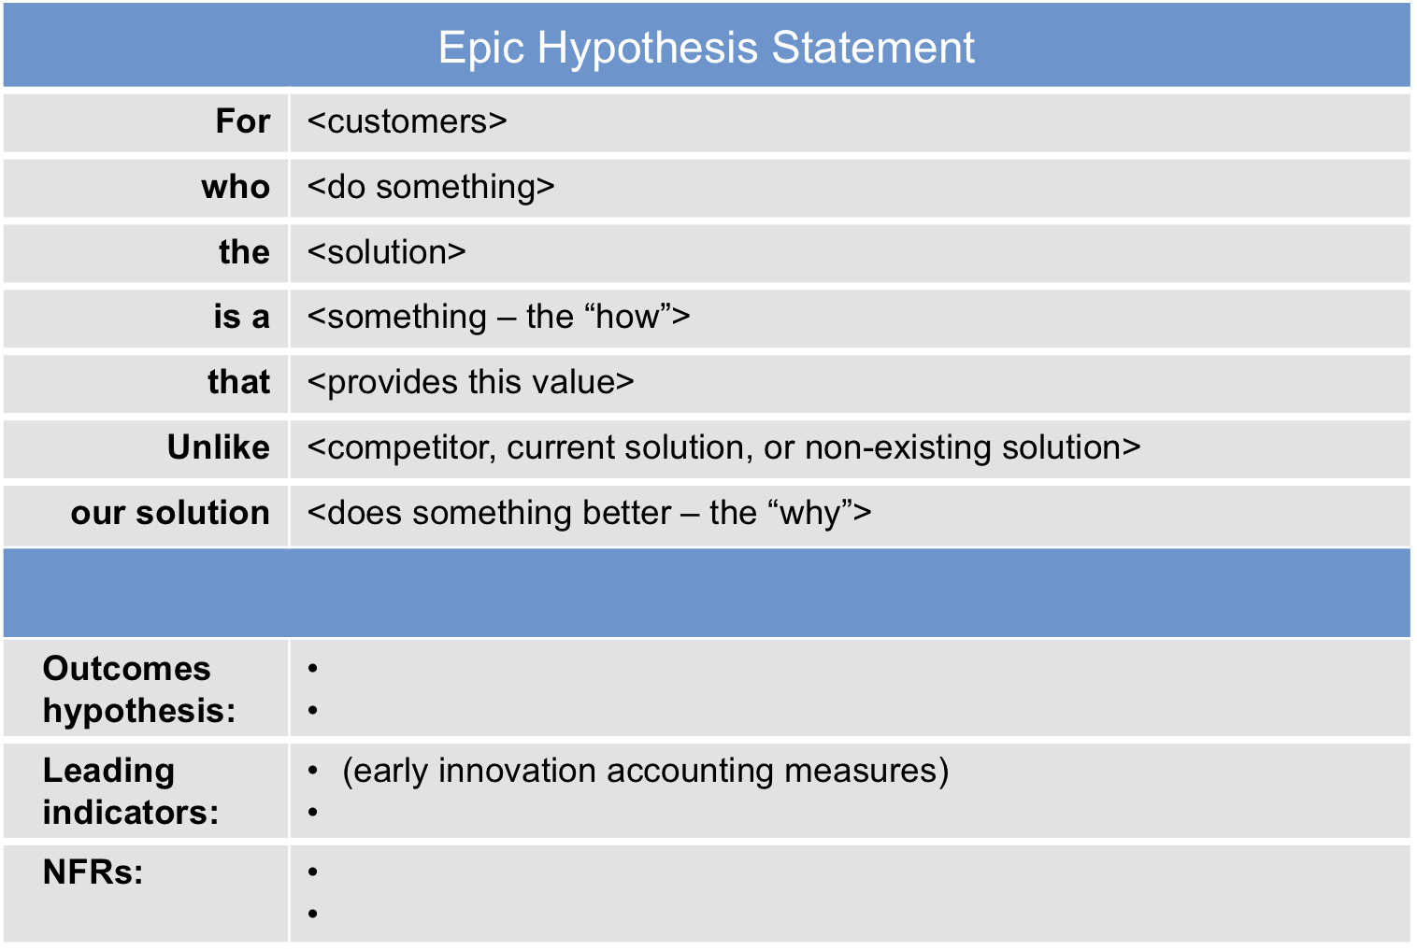

Slide 27
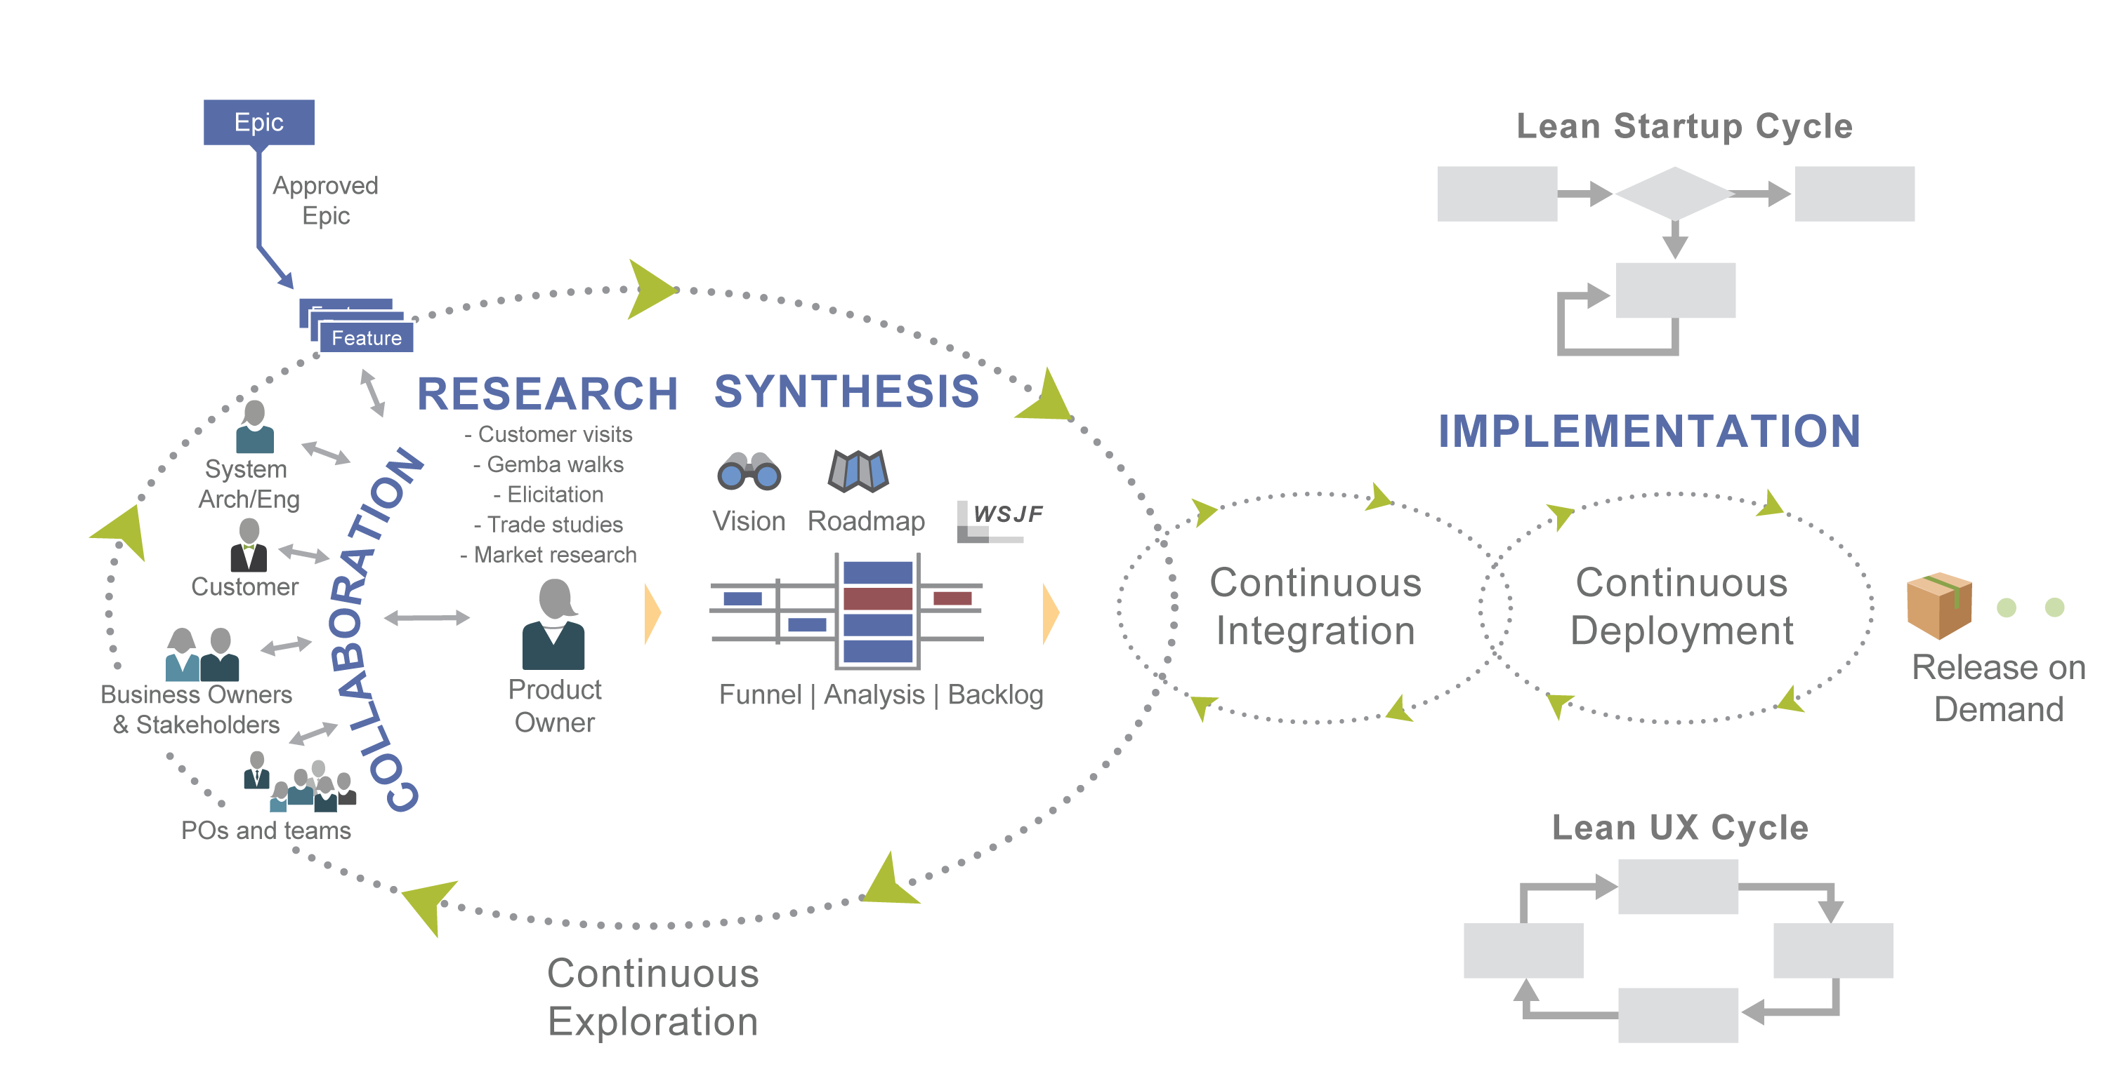
Continuous Exploration

Slide 28
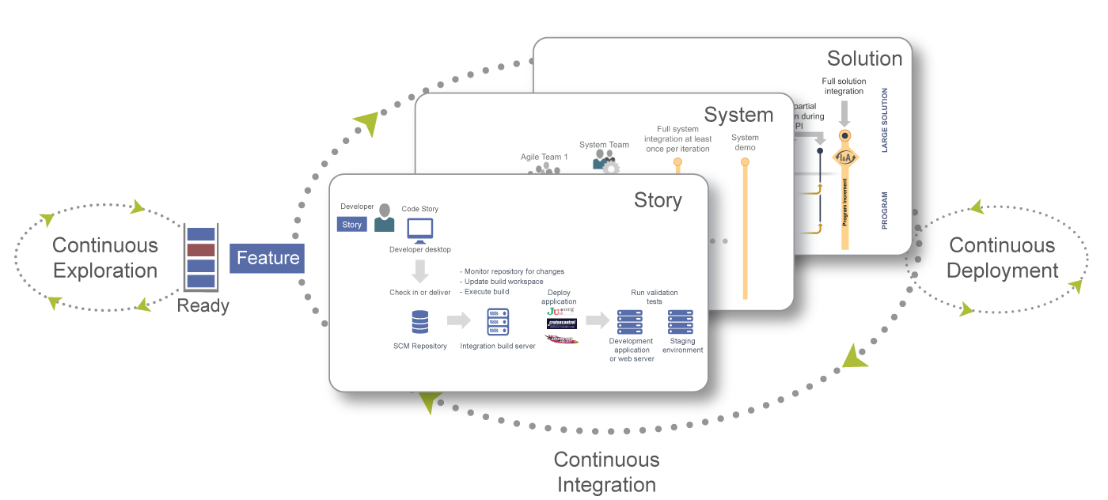
Continuous Integration

Slide 29
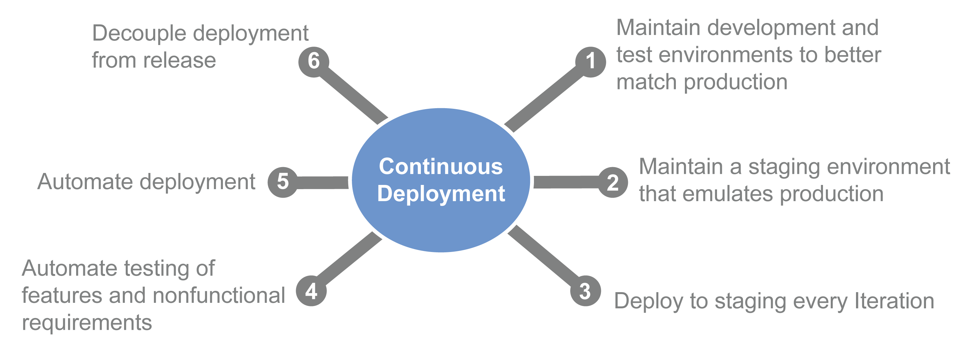
Continuous Deployment

Slide 30
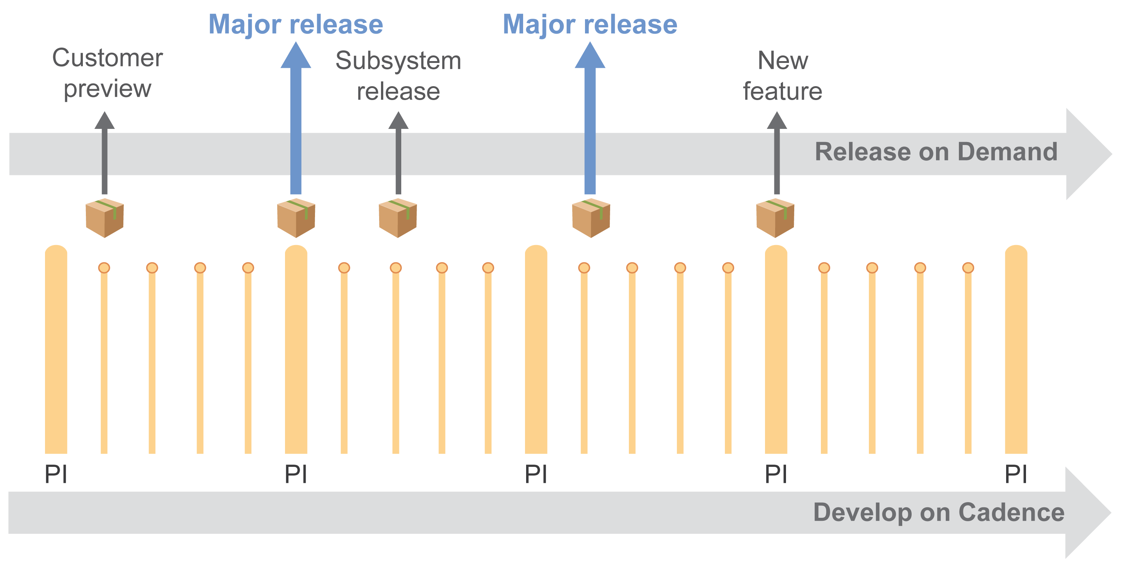
Decouple Deployment From Release

Slide 31
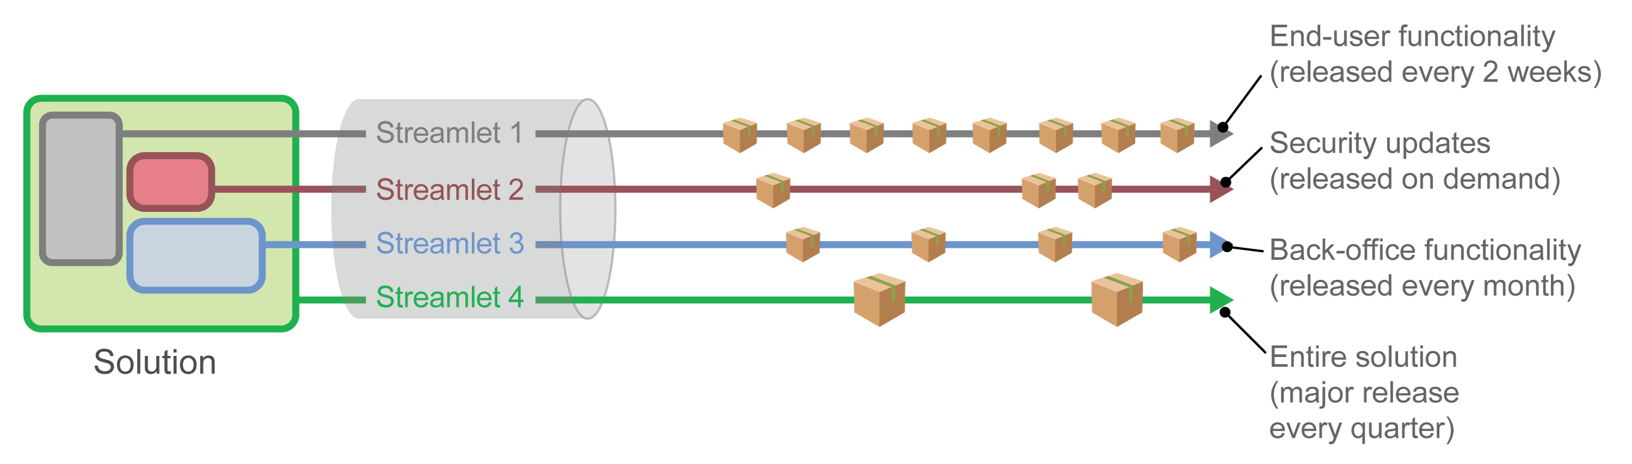
Decouple release elements from the total solution

Slide 32
New Program Kanban

Slide 33
Scalable DevOps
7

Slide 34
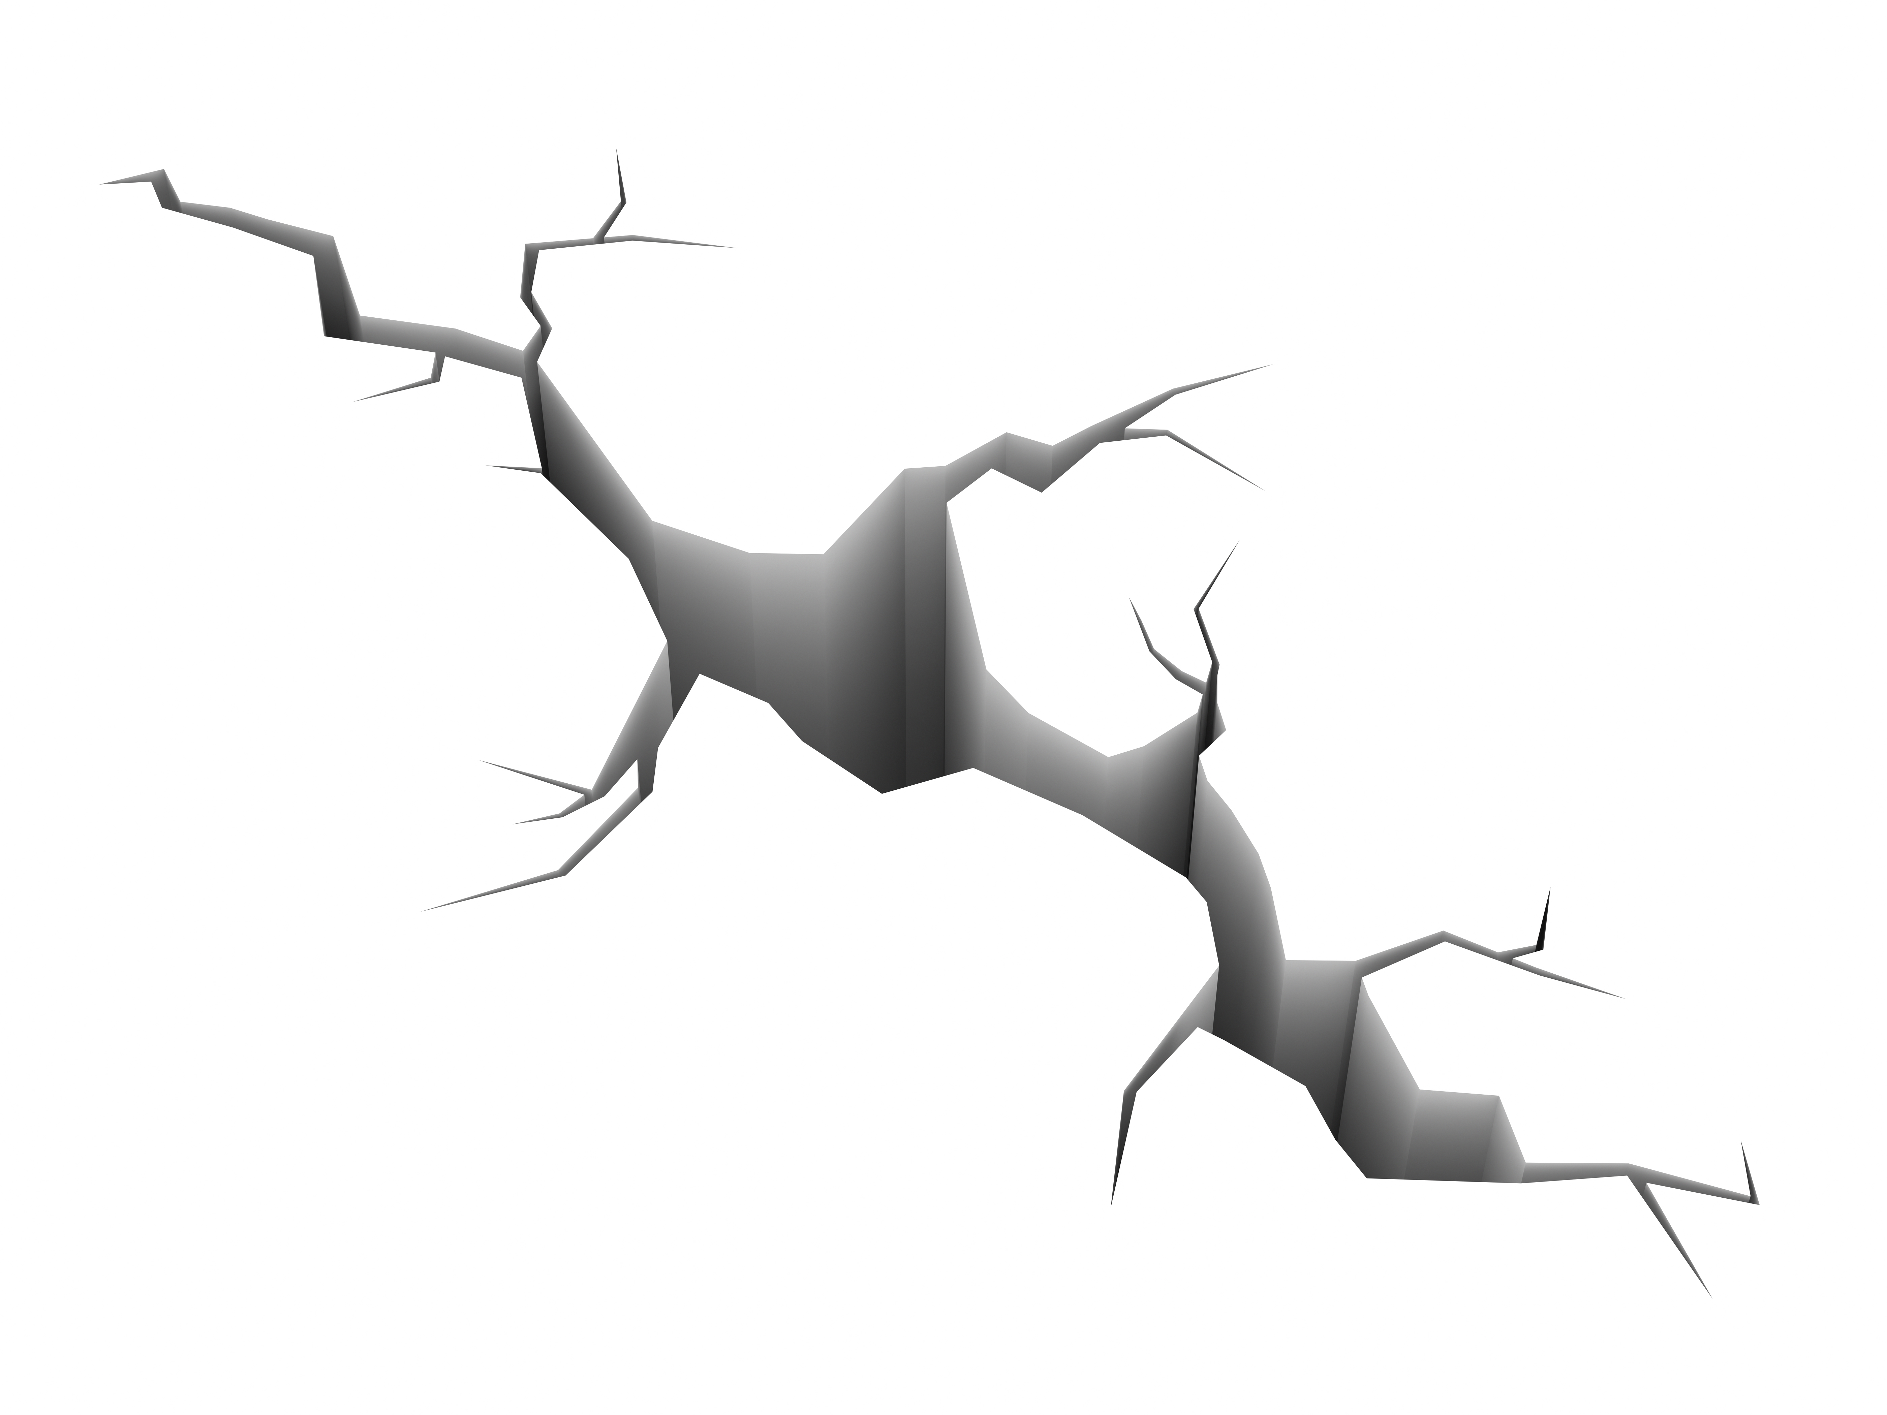
What is DevOps?
An agile approach to bridge the gap between development and operations to deliver value faster and more reliable.
Development:
Create Change
Add or Modify Features
Operations:
Create Stability
Create or enhance services
DevOps
DevOps is a capability of every Agile Release Train
Notes:
DevOps is a mindset, a culture, and a set of technical practices. It provides communication, integration, automation, and close cooperation among all the people needed to plan, develop, test, deploy, release, and maintain a Solution.
Services includes fulfilling user requests, resolving service failures, fixing problems, as well as carrying out routine operational tasks
Disconnect between Dev and Ops
Conflicts and inefficiencies
Devs don't deploy software consistently
Ops are motivated to resist change to keep things stable
Development process is often agile
Operations process is mainly waterfall

Slide 35




DevOps is IN the Value Stream
Value occurs only when the end users are operating the Solution.
DevOps
Lead time
Trigger
Define
Implement
Deploy
$
REPEAT
DevOps isn’t optional. The only question is how efficient it is.

Slide 36
A CALMR approach to DevOps
Culture
Automation
Lean flow
Measurement
Recovery

Slide 37
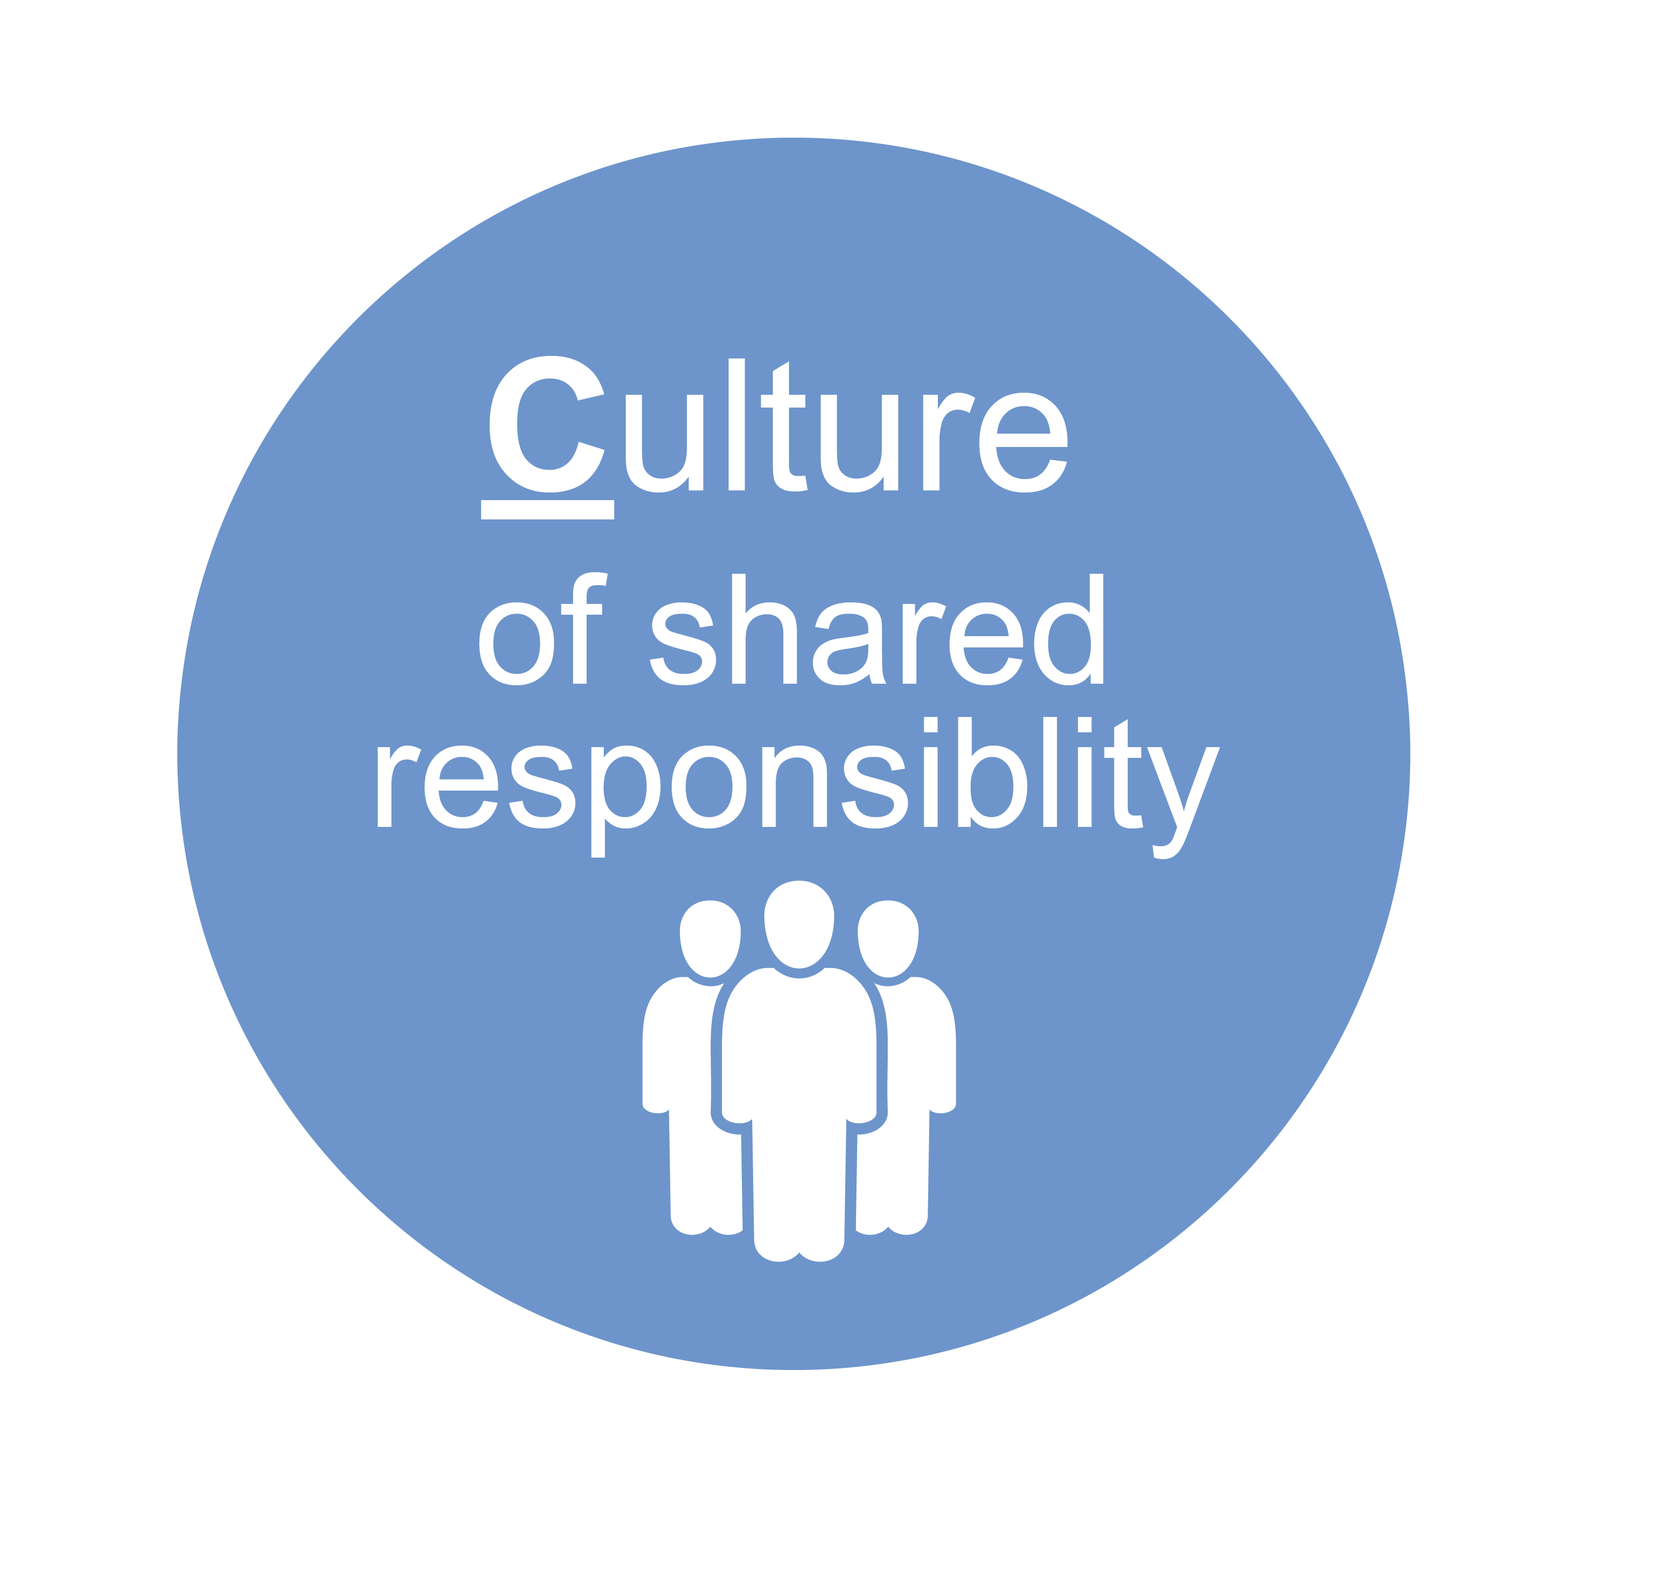
DevOps is a Cultural shift first of all
A culture of shared responsibility for development and deployment
DevOps requires a tolerance for failure and rapid recovery, and rewards risk taking
Sharing discoveries, practices, tools, and learning across silos is encouraged

Slide 38
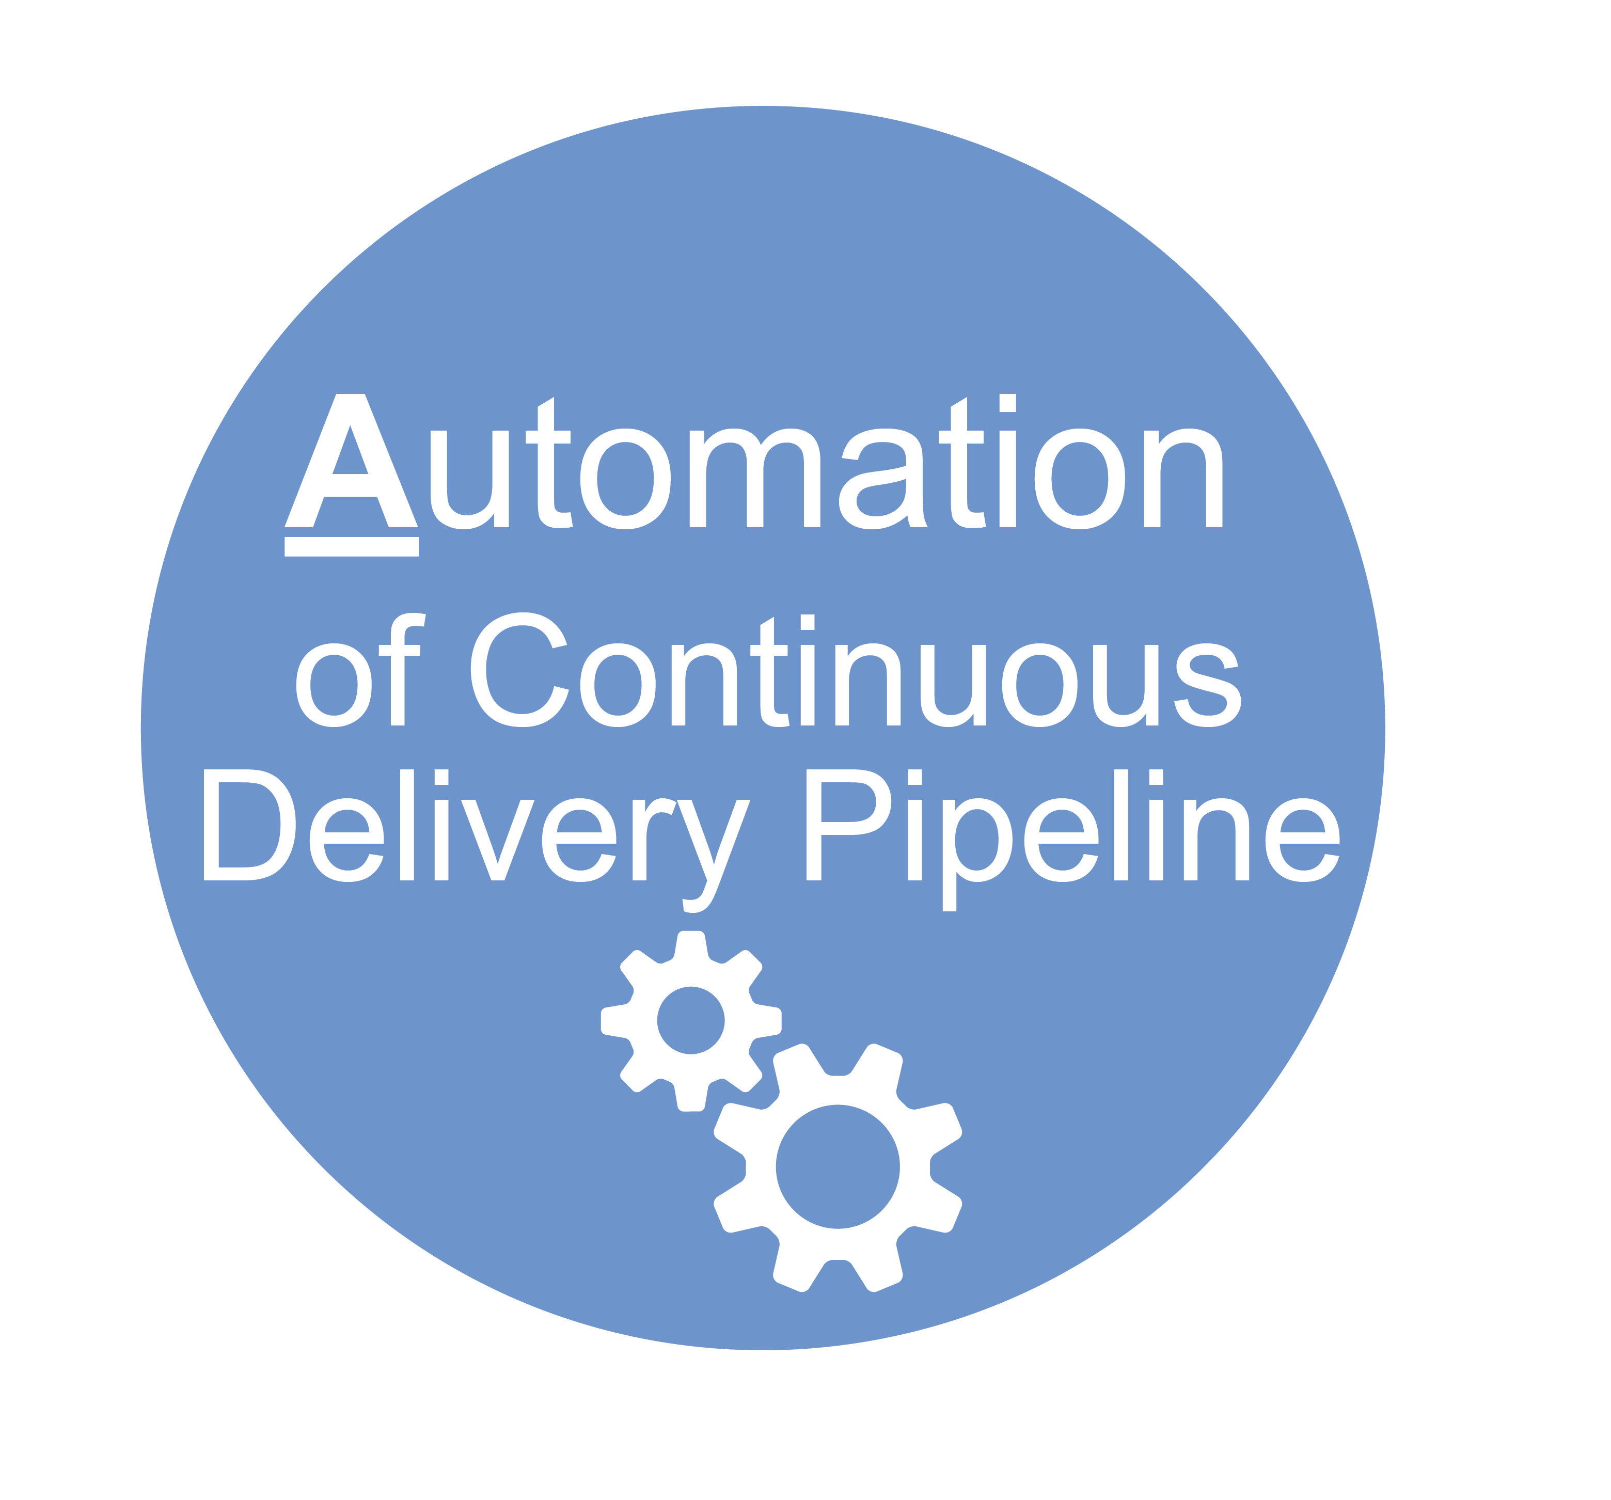
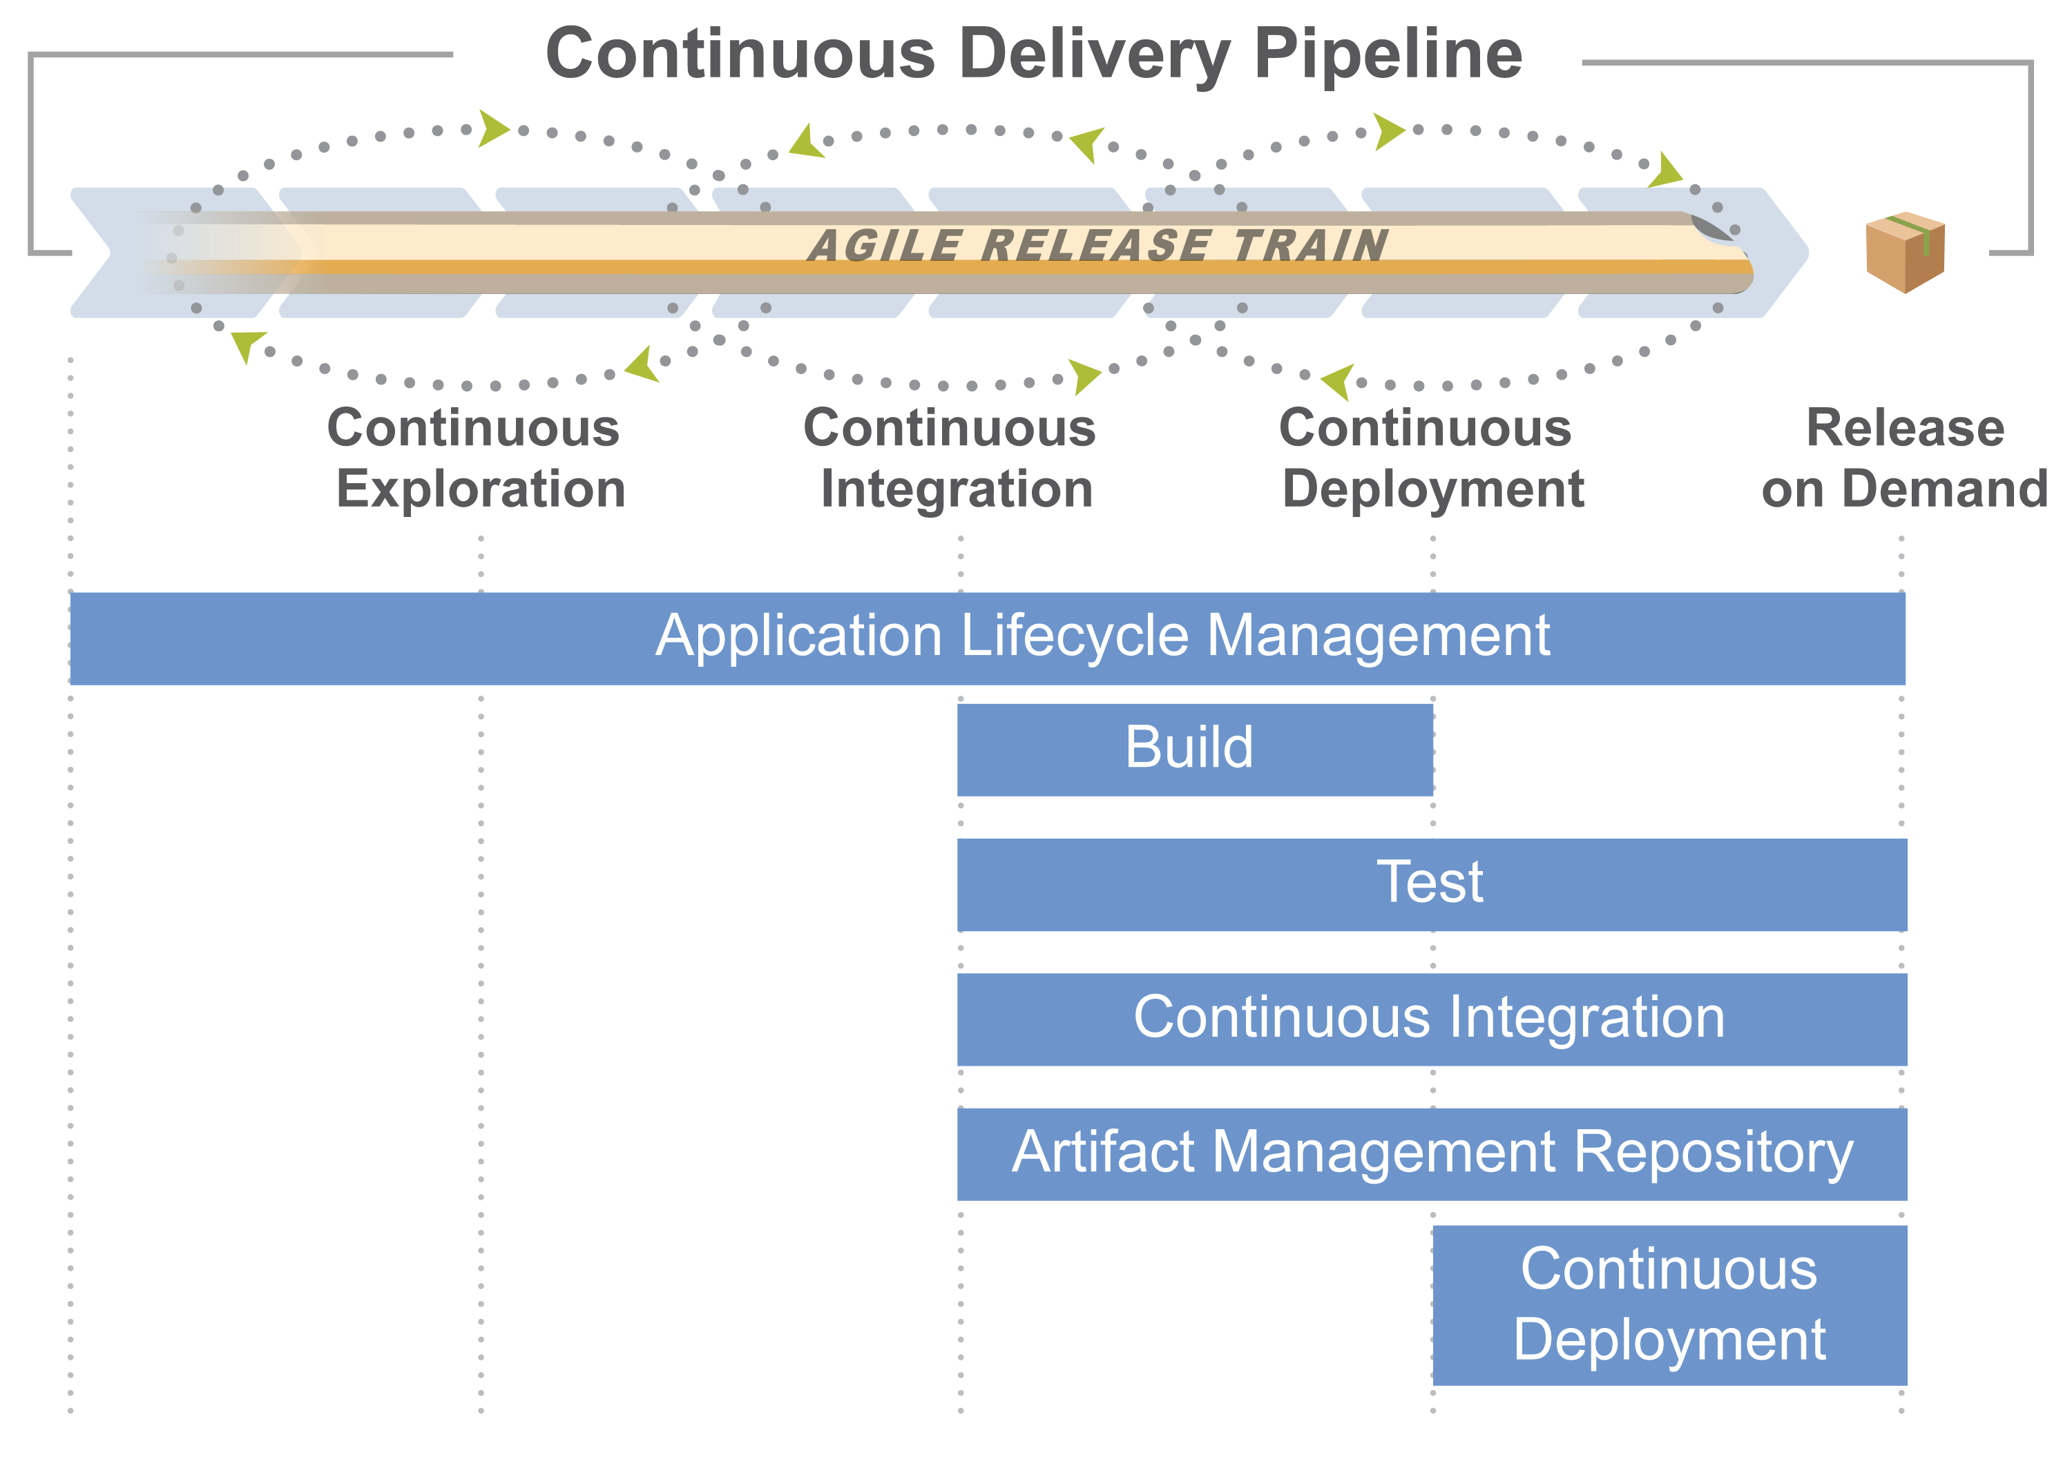
Automate the deployment process
Match development environments to production to the extent feasible
Maintain a staging environment that emulates production
Deploy a working system to staging every Iteration
Automate testing of Features and performance tests
Automate deployment
Everything under version control
Automatically build environments
Automate the actual deployment process

Slide 39
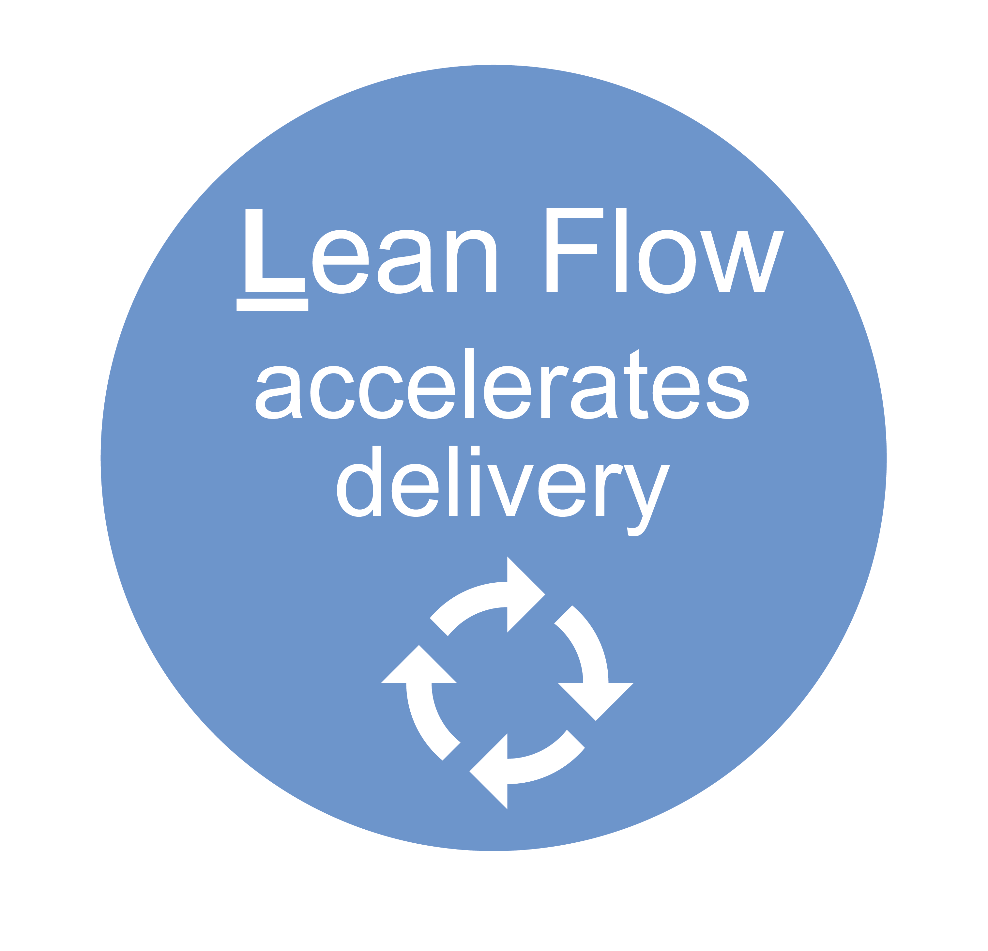
Focus on continuous Lean flow of value
Identify bottlenecks and balance the amount of WIP against the available development and operations
Decrease the batch sizes of the work
Manage and reduce, queue lengths
Notes:
Lean is not a black and white. There is a connection between the transaction and holding costs. You can see how the transaction cost changes by the size of the batch.
The more items I transfer at once, the lower the overall transaction cost is. On the other hand, the more items I have in a batch, the larger my inventories are, which increases the holding cost.
The optimal batch size is at the minimum of the aggregation of the transaction and holding costs. The aggregated values form a U-Curve, and it’s not an exact science, rather, a sweet spot.
More Examples:
U-Curve illustrates the number of batch sizes
U-Curve Optimization is a common effect in Lean, it highlights trade-offs which vary by context. Must understand transaction and holding costs.
Applies to collocation since there are greater holding costs due to batching and lower transaction costs. Want the intersection.
Applies to Iteration length, number of stories in a Iteration, number of features in a PI, amount of code developed before check in etc. etc.

Slide 40
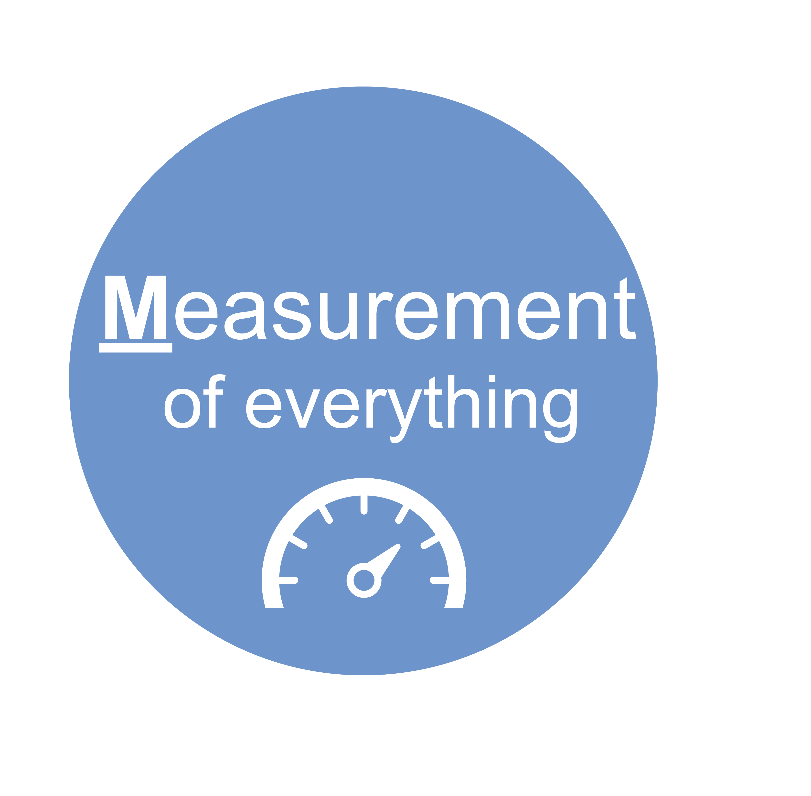
Measure everything
Collect data on business, application, infrastructure and client layers
Collect data about the deployment pipeline itself
Store logs in ways that enable analysis
Different telemetry for different stakeholders
Broadcast measurements
Overlay measurements with events (deploys, releases)
Continuously improve telemetry during and after problem solving

Slide 41
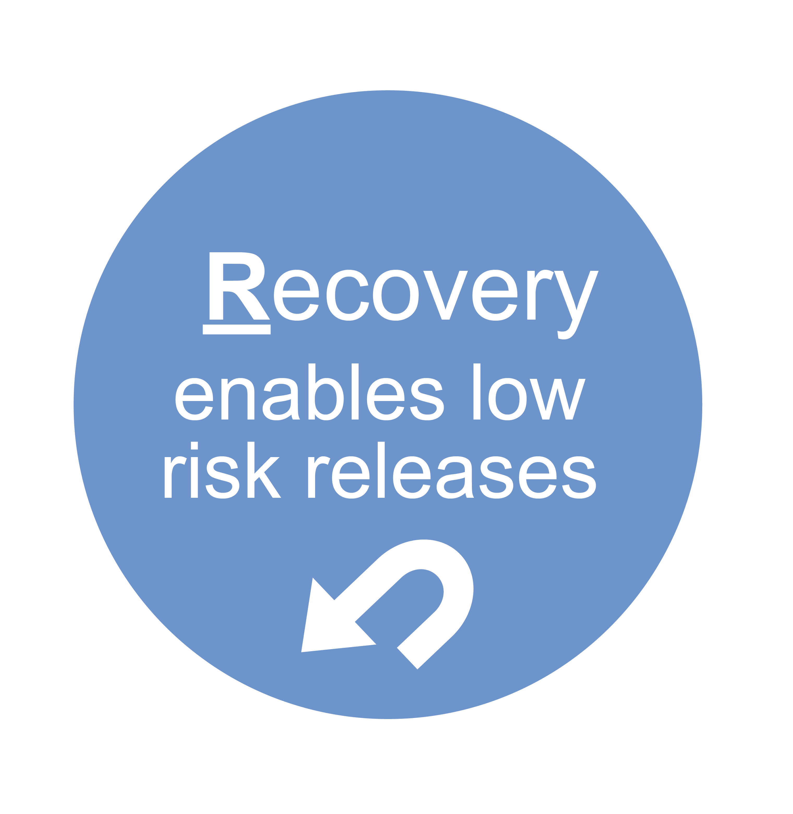
Architect for “release-ability” and Recovery
Stop-the-line mentality
Plan for and rehearse failures
Build the environment for both roll back and fix forward
Use tools such as:
Feature toggles
Dark launches
Chaos monkey
Canary Releases
Source: the DevOps Handbook: How to Create World-Class Agility, Reliability, and Security in Technology Organizations IT Revolution Press..Kim, Gene; Humble, Jez; Debois, Patrick; Willis, John

Slide 42
Lean UX
8

Slide 43
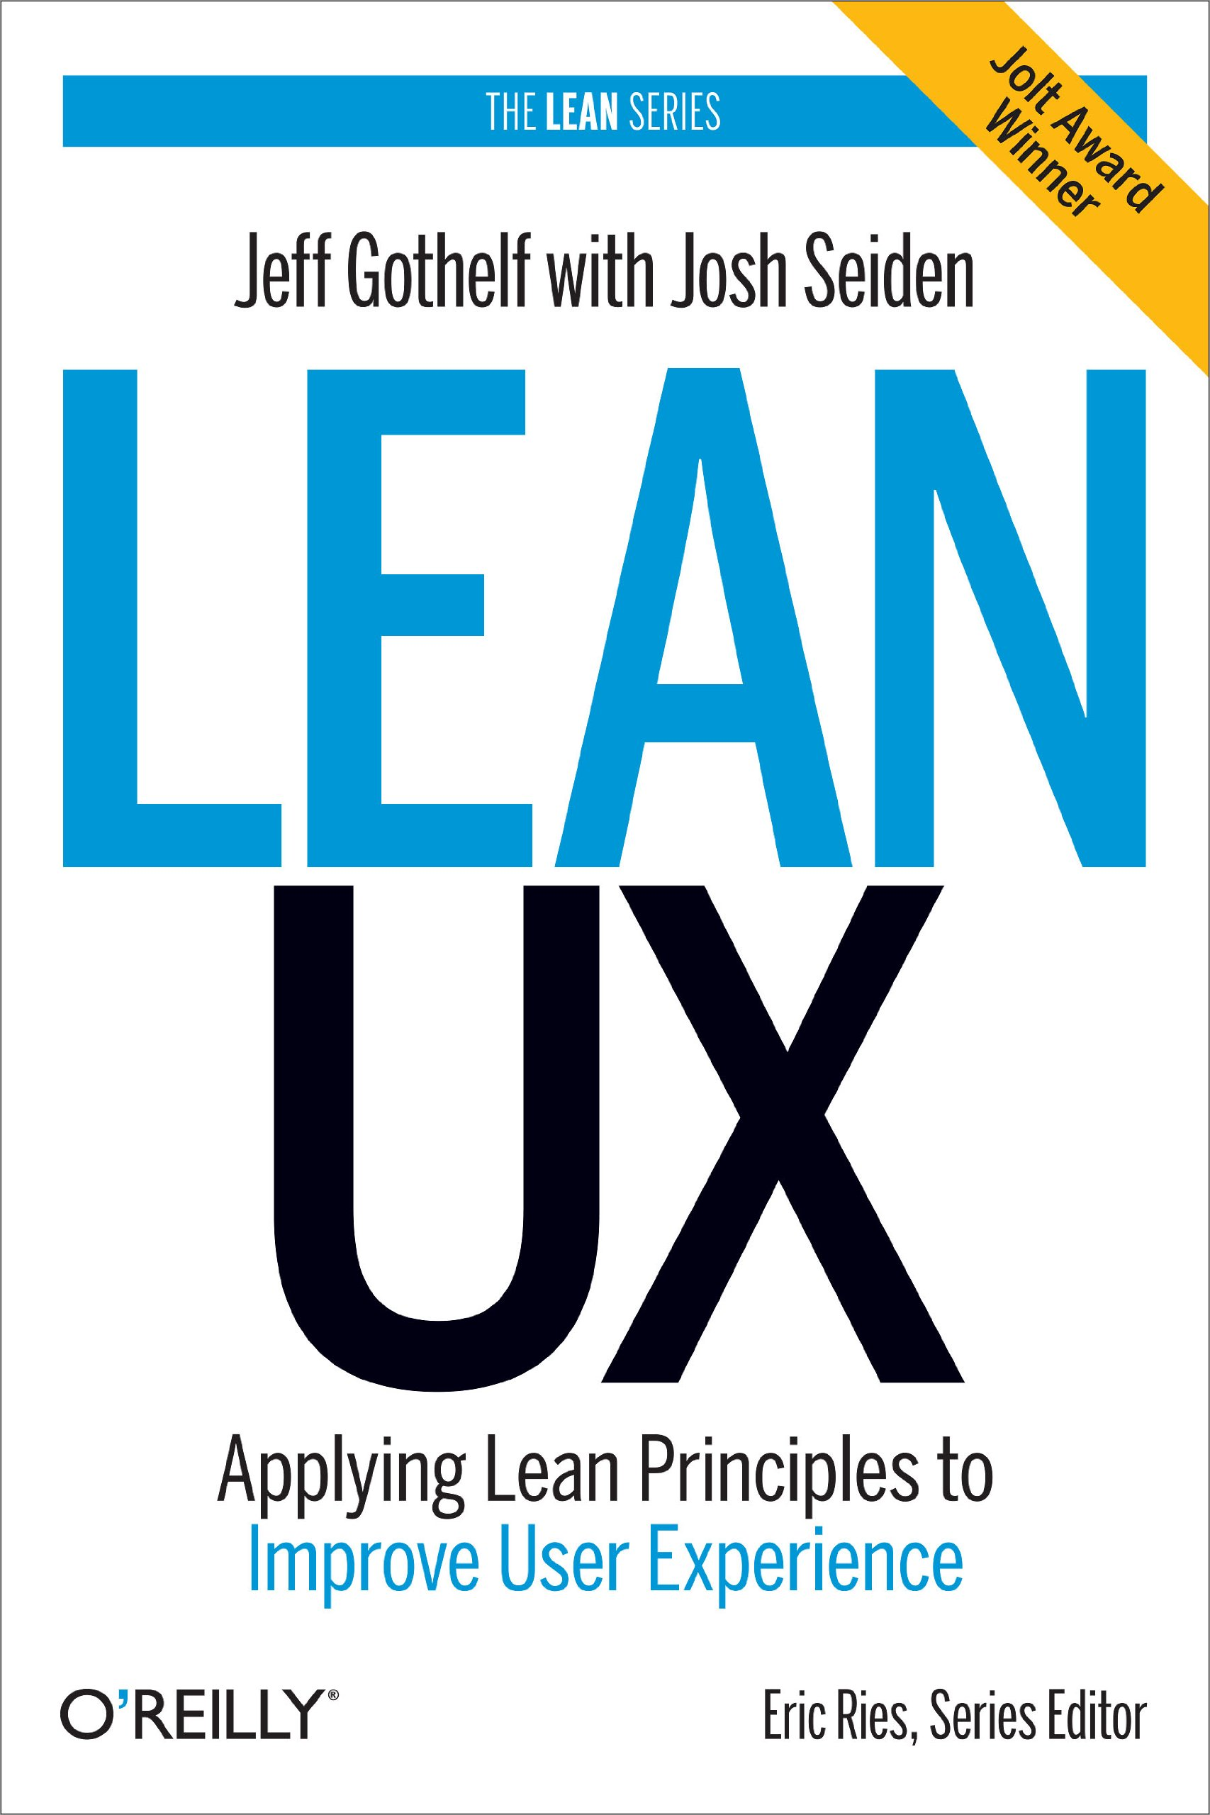
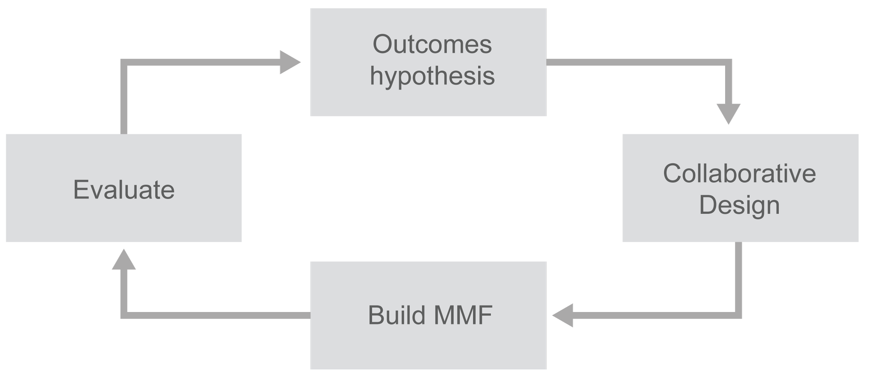
Lean User Experience (UX)
In their book Lean UX, Gothelf and Seiden describe a model that we have adapted for SAFe context.

Slide 44
Features have an outcome hypothesis
Feature: In-service software update
Benefit hypothesis: Downtime decreased by 80%
Acceptance Criteria:
Nonstop routing availability
Automatic and manual update support
Rollback capability
Support through existing admin tools
All enabled services are running after the update

Slide 45
Implementation Roadmap
9

Slide 46
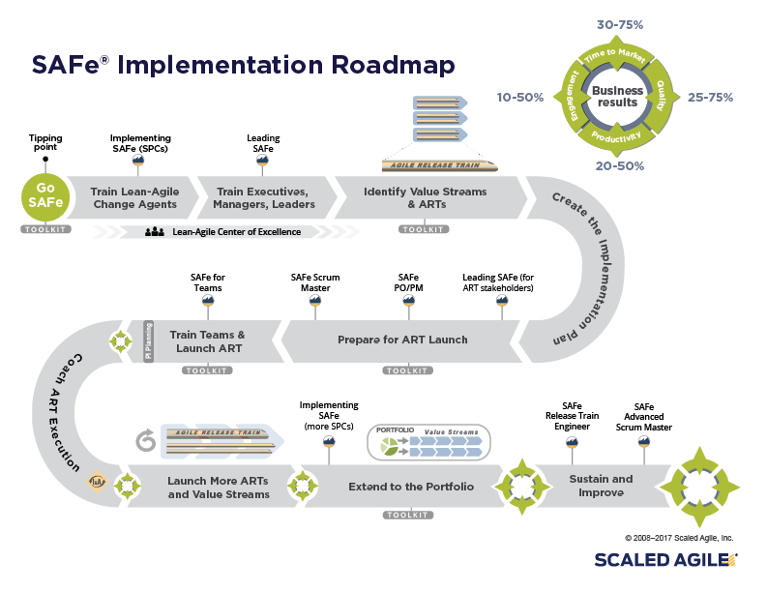
12 new articles
Links to courseware

Slide 47
SAFe Program Consultant
10

Slide 48
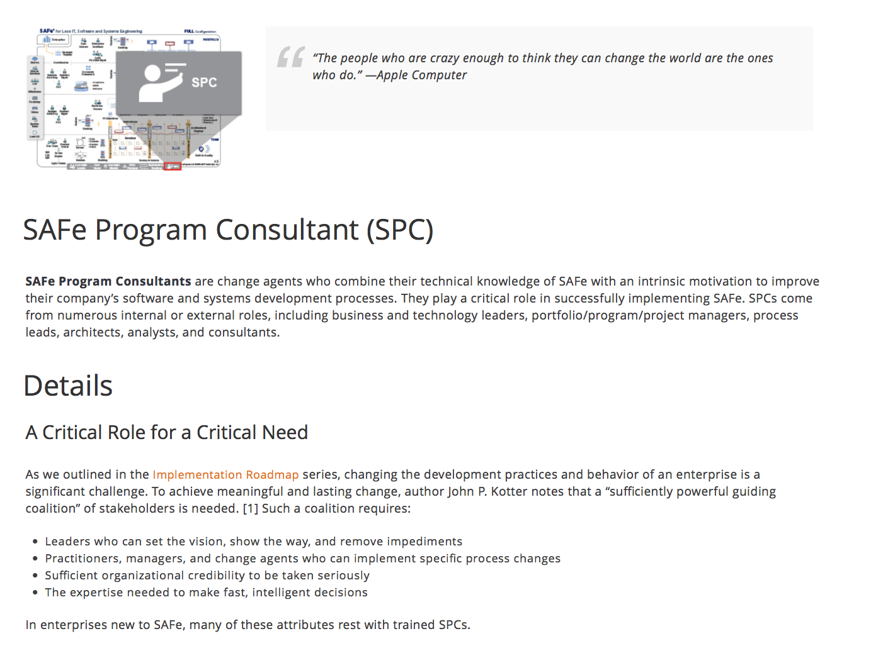
New article

Slide 49
11. Solution Train
11

Slide 50
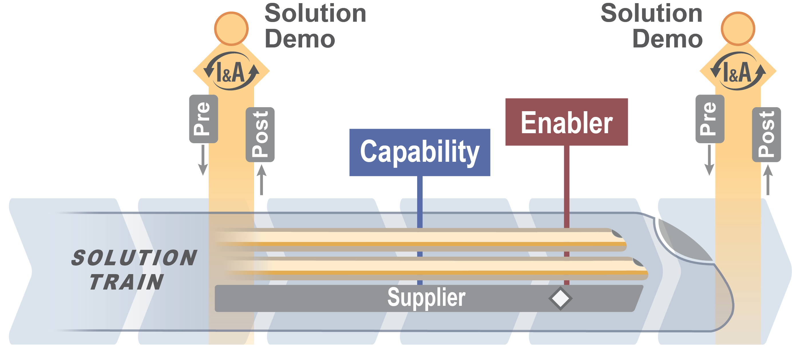

Slide 51
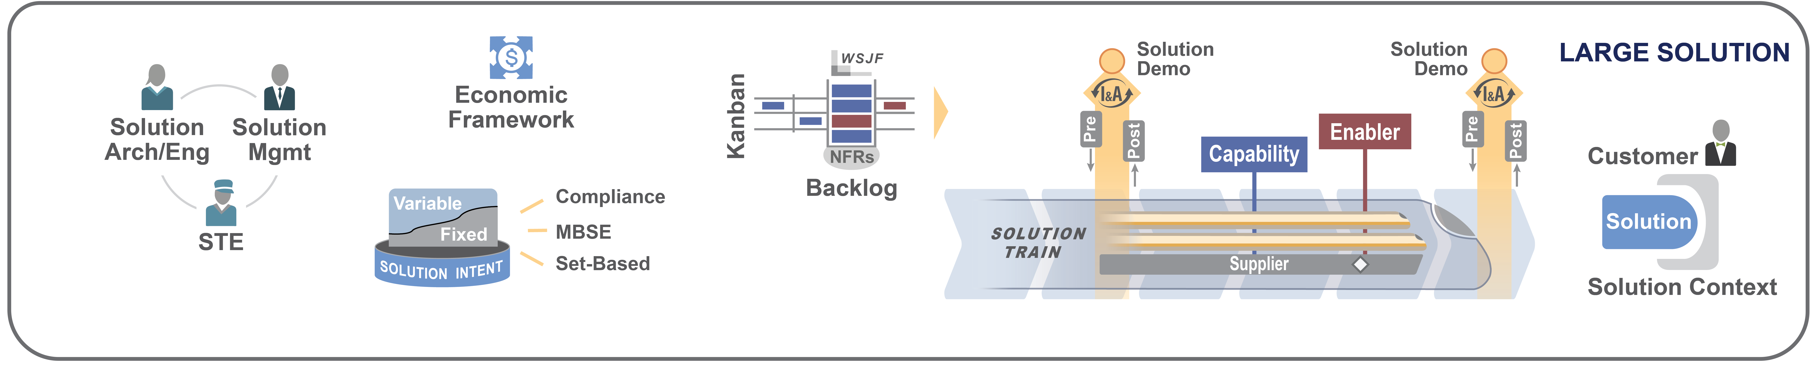
Value Stream level is now called the “Large Solutions” level

Slide 52
Compliance
12

Slide 53
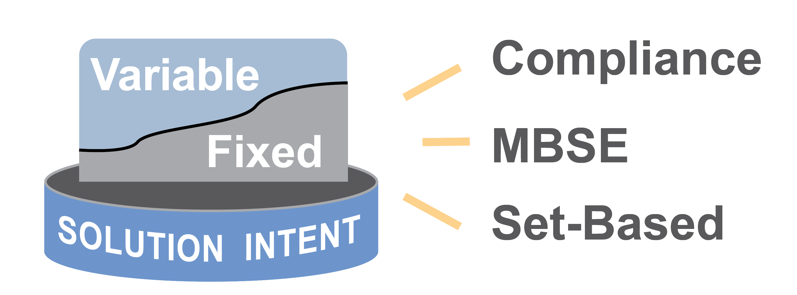
Compliance
New article
Compliance is now part of Solution Intent. Agile Architecture is now a guidance article.
Compliance enablers are used to schedule and manage specific compliance activities, including verification and validation, documentation and signoffs, and regulatory submissions and approvals

Slide 54
Other important stuff
13

Slide 55
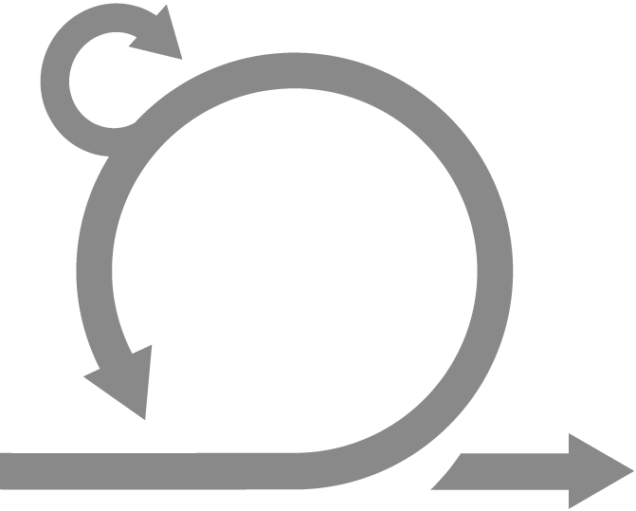





Some changes on Team Level terminology
Daily Stand-up
PO
SM
Dev Team
Review
Plan
Retro
Notes:
Point when each topic will be covered in class

Slide 56
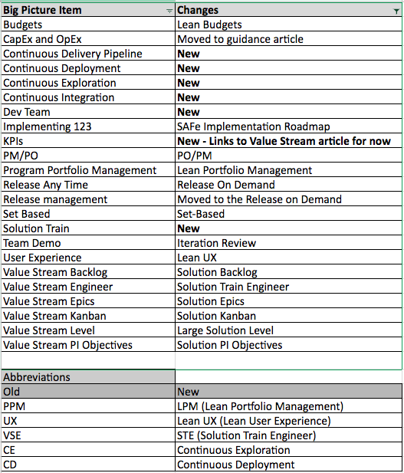
Terminology changes

